Slide 1
Notes:
https://openknowledge.worldbank.org/handle/10986/32354

Slide 2
Many contributors:
Tom Bundervoet, Alejandro de la Fuente, Lionel Demery, Patrick Eozenou, Ruth Hill, Isis Gaddis, Siddharta Raja, Joachim Vandercasteelen, Philip Verwimp, Eleni Yitbarek

Slide 3
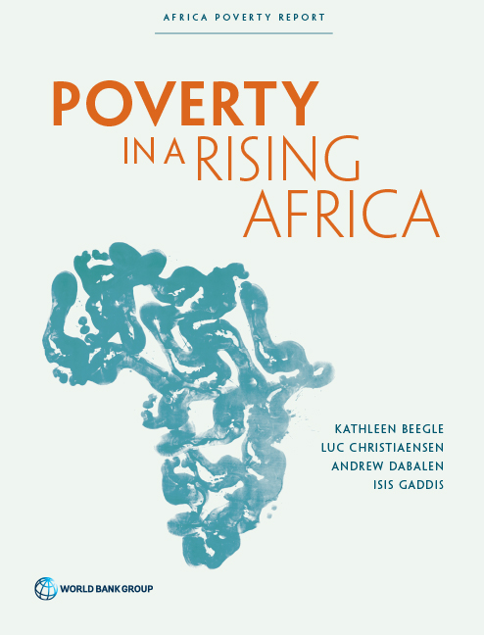
https://openknowledge.worldbank.org/handle/10986/22575
Major trends in Africa’s living standards, with attention to the robustness of the data.
Accelerating poverty reduction in Africa explores what to do about it …
Notes:
Sequel to Beegle, Christiaensen, Dabalen and Gaddis, 2016, Poverty in a Rising Africa, World Bank, http://www.worldbank.org/africa/povertyreport which focused on mapping the evolution of poverty reduction (monetary and non-monetary dimensions) and the associated data challenge

Slide 4
Outline
A broad profile of poverty in Africa
Principles of engagement
Four primary areas for policy action
Accelerate the fertility transition
Leverage the food system, on and off the farm
Address risk and conflict
Mobilize public finance for the poverty agenda

Slide 5
Insights from a case study in Kagera, Tanzania
I. A broad profile of poverty in Africa

Slide 6
Poverty rate in Africa has gone down, but the number of poor has increased
1,006 million
In 2015
African population:
512 million in 1990
Number of poor
278 million
Population living on $1.9 a day or less
413 million
Notes:
Source: World Bank PovcalNet data, http://
iresearch.worldbank.org/PovcalNet.

Slide 7
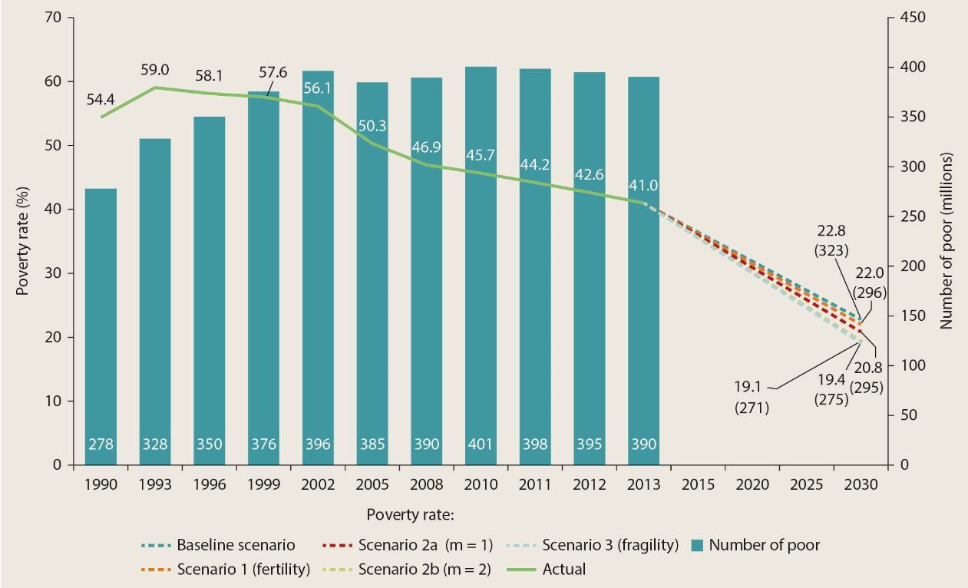
Africa cannot eradicate poverty by 2030, but can accelerate poverty reduction
Business as usual: poverty declines to 22.8%.
More inclusive growth can accelerate poverty reduction.
Since 2014-15, poverty reduction likely already off track following slow down in Africa’s growth.
Notes:
GDP/cap growth for Africa as a whole, even negative during 2016-19
Forecasts suggest only modest improvement in GDP growth/cap from -0.3 % in 2018 to to 0.7% in 2021; w/o Nigeria, South Africa, Angola (which host 25% of Africa’s poor) – GDP growth/cap dropped to below 2% during 2016-18 (also below LR average)
Figure 1.2
S1(m=0): Distribution neutral growth
S2(m=2): B40 grows 2%points faster than average → 50 million more people out of poverty
Source: World Bank calculations.
Note: The poverty rate is the percentage of the population living at or below US$1.90 per day.
The baseline scenario assumes average distribution-neutral growth of 2.8 percent per
year.
Scenario 1 assumes a low-fertility population growth scenario instead of the historical population growth rates.
Scenario 2a assumes more pro-poor growth, with average GDP
growth the same as in the baseline scenario but with the incomes of the poor growing 1 percentage point faster than the historical average.
Scenario 2b also holds average GDP
growth the same as in the baseline scenario, but assumes annual income growth among the poor that is 2 percentage points faster than the historical average.
Scenario 3 assumes
that increased policy attention would make Africa’s fragile states grow 3 percentage points faster than their historical average.

Slide 8
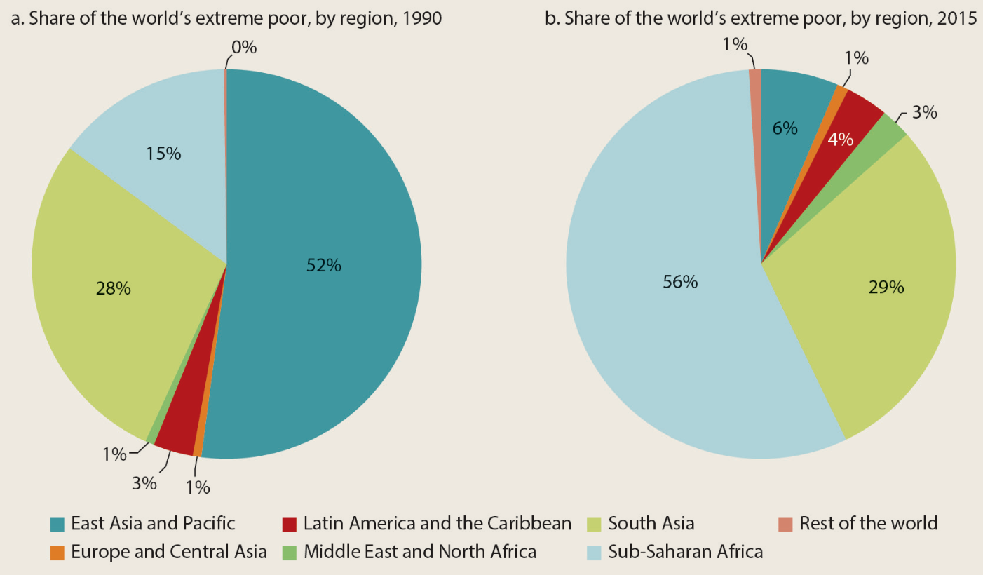
Poverty reduction in Africa – Increasingly a global agenda
Notes:
Figure I.1
Source: World Bank 2018.
Note: “Extreme poor” refers to the percentage of the population living below US$1.90 per person per day.

Slide 9
Poverty reduction in Africa – Increasingly a global agenda
2030: Africa’s world poverty share will rise to 90% (BAU)
Notes:
Increasing migration pressures: bifurcating demography (youth bulge in Africa; ageing western world), climate change and rising inequality.

Slide 10
Insights from a case study in Kagera, Tanzania
The context of Africa’s poverty reduction

Slide 11
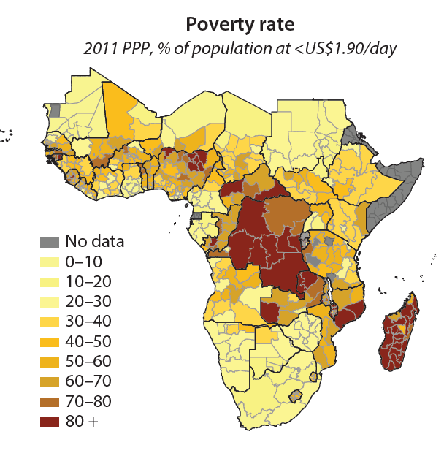
1. Africa’s poor concentrated in few countries, with high poverty in fragile states
5 countries house 50% of Africa’s poor; 10 countries 75%.
Countries/regions w/ many poor often differ from those with high poverty rates (e.g. UG & CAR), but higher poverty rates may induce conflict.
Poverty rates higher & poverty decline slower in fragile states; ~1/3 of the poor live in fragile and conflict affected states, & # acts of violence increasing.
Notes:
Ranking countries by the largest number of poor people shows that Nigeria accounts for about 20 percent of Africa’s poor (85.2 million); the next four countries (the Democratic Republic of Congo, Tanzania, Ethiopia, and Madagascar) account for another 30 percent; and the next five countries (Mozambique, Uganda, Malawi, Kenya, and Zambia) account for 25 percent.
CAR – 3.6 million people; poverty rate of 79%
Uganda – 13 million people, poverty rate 34.5 percent
High poverty rates often induce conflict, especially when coinciding with ethnic, religious, language concentration.
Map 1.1
Source: World Bank’s internal Global Monitoring Database.
Note: PPP = purchasing power parity.
Poverty estimates are based on the latest available household survey.

Slide 12
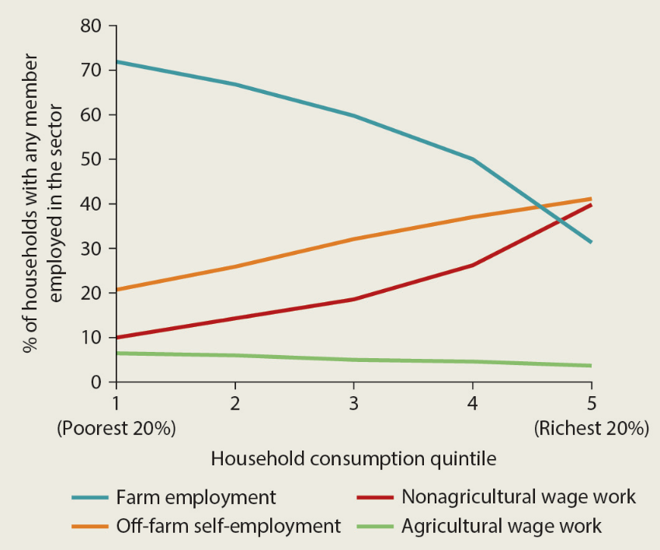
2. Poverty remains predominantly rural, with earnings mainly coming from agriculture
Sector of work
by income quintile
82% of Africa’s poor are rural.
The poor derived 70% of their income from farming.
They mainly work for their own account.
Nonwage micro-enterprises (1 person, often in ag related activities) main source of non-farm employment and income.
Notes:
The rural and agricultural reality provides the entry point into policies for Africa’s poverty reduction, which does not by itself imply actions should be focused on stimulating rural and agricultural development.
Figure 4.1
Sources: World Bank Africa Poverty database and International Income Distribution Database (I2D2).
Note: Figure represents data from 40 African countries.
Informal “household enterprises”—a business activity owned and operated by one or more household members with no hired labor—are the most common form of off-the-farm self-employment in Africa.

Slide 13
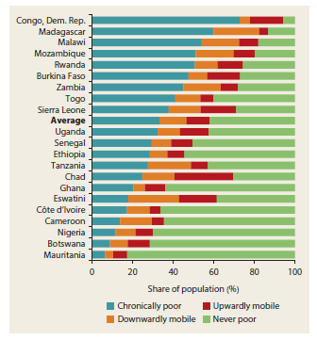
3. Poverty is a mix of chronic and transitory
60% of Africa’s poor are chronically poor; 40 % transitorily poor
Poverty is still deeply structural, following a lack of assets (human capital, for some land), weak access to public goods, and poor locations.
Risks remain pervasive, and coping capacity limited with shocks pushing & holding people back.
Notes:
Note: agro-ecologically better endowed regions tend to be poorer (housing more poor people and displaying higher poverty rates).
Source: Dang and Dabalen 2018.
Note: Poverty statistics refer to the latest household survey year for each country.
The “chronically poor” category includes households that were poor in both periods of the analysis; “downwardly mobile” refers to households that fell into poverty in the second period; “upwardly mobile” includes those who were poor in the first period but not poor in the second period; and “never poor” includes households that were nonpoor in both periods.

Slide 14
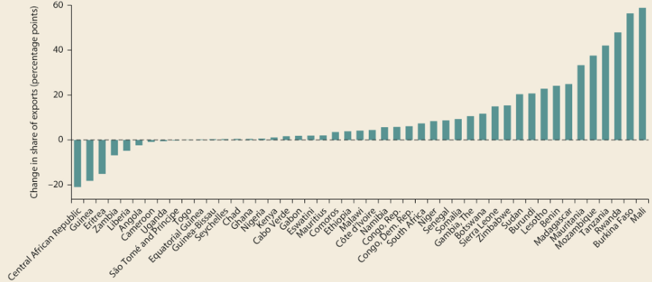
4. Natural resource dependence has risen, and with it the governance challenge
Share of mineral exports in total exports, 1996-2013
Resource dependence undermines institutional quality
Relatively less and less efficient public spending on sectors benefiting the poor
Better use of natural resource revenue is important for Africa’s poverty agenda.
Notes:
No positive (or negative) payoff for the rest of the economy.
Negative effect on institutions and governance.
Induces the emergence of “consumption cities,” where workers are engaged principally in nontraded sectors (personal services and commerce), with higher poverty than “production cities”.
Adversely influences public spending on sectors that benefit the poor (agricultural research and development, education, and health).
Figure 2.3
Source: Calculations based on United Nations Conference on Trade and Development (UNCTAD) data.
Note: There is a close correlation between the export and government revenue shares of natural resources. Data on the latter, although arguably the better indicator of resource
dependence, are patchy.

Slide 15
5. Fiscal space is tightening, again
0% GDP per capita growth in last 3 years.
46 percent of countries at high risk or in debt distress at end of 2018, compared to 22% in 2013.
With debt management risking to come at the expense of spending on social sectors, as in the past, the poor and their children stand to suffer most.
Notes:
Africa Pulse 2019:
“Per capita GDP growth for the region as a whole has remained relatively flat, with no gain expected in 2019 (figure 1.29). Per capita GDP growth is projected at 0.5 percent in 2020 and 0.6 percent in 2021, well below the growth needed to improve the living standards of the region’s population”
“gross government debt in Africa has increased from about 36 percent of GDP in 2013 to 55 percent of GDP in 2018. About 46 percent of countries in the region were considered at high risk or in debt distress at the end of 2018, compared with 22 percent in 2013.”

Slide 16
Five key features - remarks
These features provide a backdrop for the future design of Africa’s poverty reduction strategies.
Many are not new (rural/ag concentration; lack of assets).
But some have been relatively neglected (population growth, gender inequality, risk mgt and fragility, including climate change).
Or have come to the fore more recently (resource dependence, tightening fiscal environment, growing concentration of the world’s poor).
Technological developments also offer new opportunities (ICT, solar)

Slide 17
Insights from a case study in Kagera, Tanzania
II. Principles of engagement for faster poverty reduction

Slide 18
1. Put the poor in the driver seat of poverty reduction
Africa’s slower poverty reduction despite 4.6% annual GDP growth (1995-2013) driven by the composition of Africa’s growth: capital intensive natural resources & low productive services, which generate fewer benefits for the poor.
Scope for redistribution limited.
Enable the poor to grow their earnings directly, in self- or wage employment and to manage risks.
Notes:
Unclear that a pro-growth strategy has worked in Africa and the distinction between pro-growth and distribution oriented policies not always clear
Poor initial conditions - assets, redistributive pressures, mental bandwidth
(incomes of the poor growing 2% point faster than historical average, holding overall GDP growth constant, can lift 50 million more people out of poverty)
Growth where the poor work and live, while managing the risks.

Slide 19
2. Strive for integration
Input, factor and output market constraints that hold the poor back from raising their incomes often act like quasi-complements.
Yet, too often single-focus interventions are pursued (skills training for youth, smart fertilizer subsidization, irrigation infrastructure w/o proper water management institutions).
Joint-up interventions hold promise (Ethiopia’s rural development; micro-studies – graduation programs), but rising complexity from integration challenges implementation.
Better integration of poverty interventions is advanced as second guiding principle of engagement though with an eye on experimentation and learning to get the balance right.
Notes:
Examples of single focus interventions – skill training for youth employment w/o consideration of demand for their goods and services; agricultural machinery subsidization

Slide 20
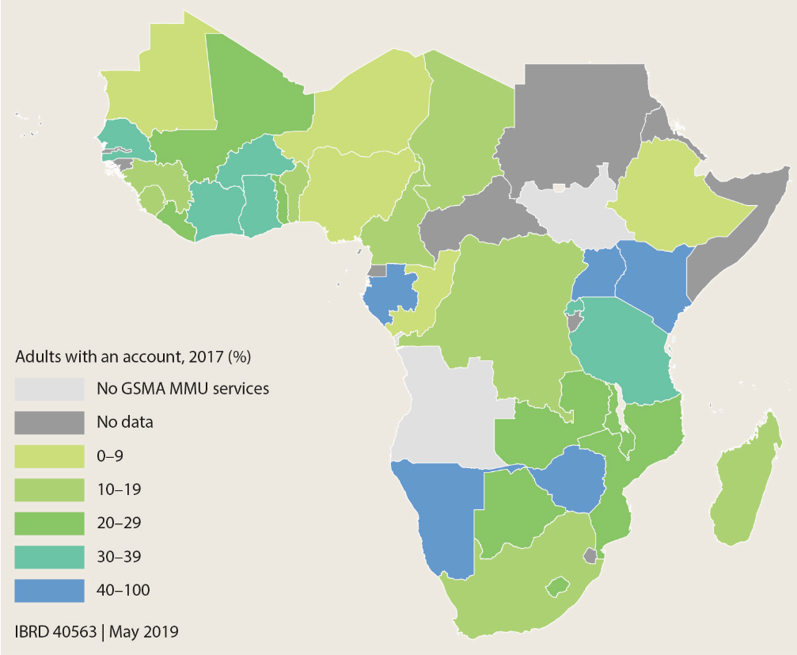
3. Leverage and leapfrog with technology
Mobile money accounts
ICT, but also solar, and combined with new business models enable overcoming infrastructure gaps.
The new technologies spread rapidly, but also need complementary measures (regulations for access, skills, business climate) to be effective.
Notes:
New business models (bite sized consumption; pay as you go)
Transport gaps in communication, energy, transport
Figure BF3.1.1
Source: Demirgüç-Kunt et al. 2018.
Note: “No GSMA MMU services” indicates the absence of mobile money account services included in the Global System for Mobile Association (GSMA) Mobile Money
for the Unbanked (MMU) database.

Slide 21
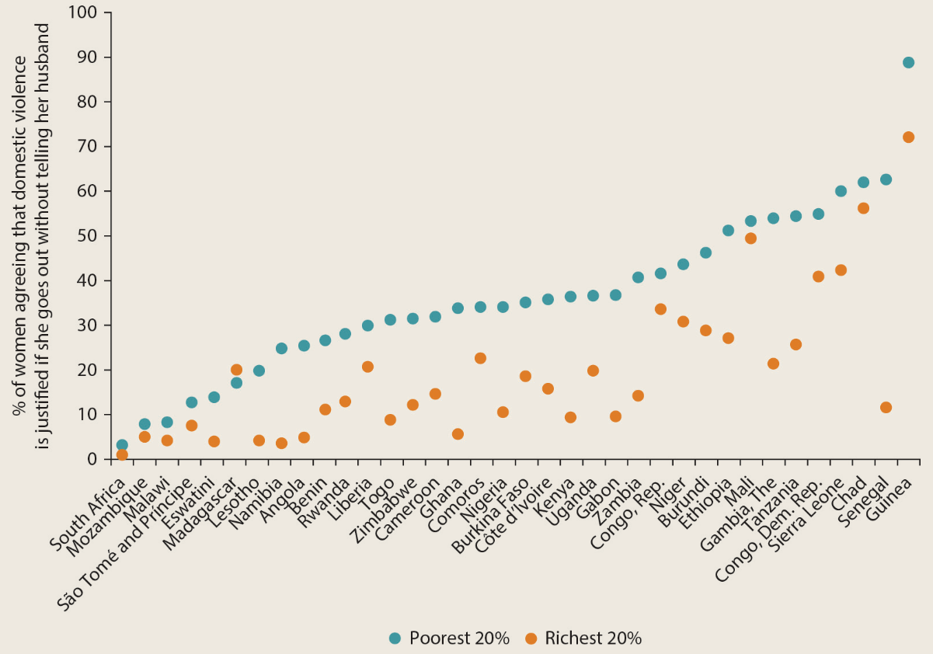
4. Address gender inequalities
Norms constrain (poor) women’s physical mobility, especially in western and central Africa
Notes:
Source: DHS Program STATcompiler, U.S. Agency for International Development: https://www.statcompiler.com/en/.
Possible policy entry points interventions (p150-151)
Education – lowering cost of education (Kenya – Duflo, Dupas and Kremer, 2015; Friedman et al. 2016)
Health – lowering maternal deaths through access to pre-natal care, skilled care during child birth, postpartum care (supply and demand side issues)
Time use – child care services; labor saving technologies; public infrastructure (water/sanitation/electricity/rural roads)
Financial inclusion – savings with element of illiquidity; legislative reform to strengthen women’s inheritance rights; land formalization programs
Gender based violence -

Slide 22
Insights from a case study in Kagera, Tanzania
III. Four primary areas for policy action

Slide 23
Insights from a case study in Kagera, Tanzania
Action area 1.
Accelerate the fertility transition in high fertility contexts

Slide 24
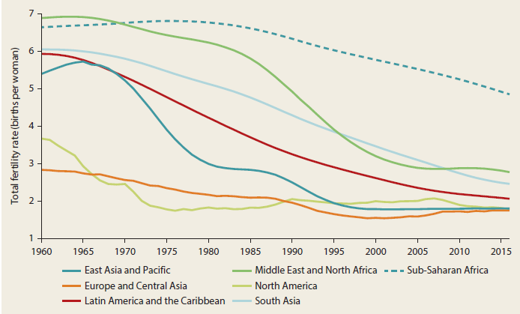
Still high fertility and slow decline in many countries
62% of population living in countries (19) with TFR>5
TFR higher in poor households
Africa
Notes:
Source: World Development Indicators database.
Note: The total fertility rate is the average number of children born to a woman in her lifetime.

Slide 25
High fertility undermines growth & poverty reduction
Fiscal pressures (schooling and health investments), land pressures, decreased income opportunities for women.
Lowering fertility in high-fertility countries increases growth because:
Higher share of working age population.
Greater income opportunities, especially for women.
More human capital investment per child.

Slide 26
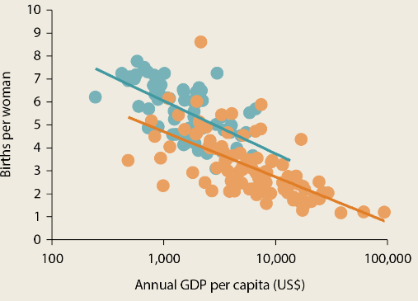
The “Africa Effect”
Relationship between
TFR and GDP per capita
Having accounted for the demographic and socio-economic factors, TFR in African countries is ~1 birth higher.
Bongaarts labels this the “Africa Effect”.
Notes:
African societies are “exceptionally” pro-natalist relative to other low- and middle-income countries (Bongaarts 2017; Bongaarts and Casterline 2013). This may partly reflect the lower empowerment of women in the region compared with peer countries in other contexts.
Source: World Bank calculations, adapted from Bongaarts (2017), using latest data from the World Development Indicators 2019 database.
Note: LDCs = least developed countries (as defined by the United Nations Committee for Development Policy); TFR = total fertility rate (total number of children born to a woman in
her lifetime). Data used are for the years 1990 and 2018. Last available year chosen when data were missing.

Slide 27
Accelerate the fertility transition
Family planning
- effective in other settings
- # of unwanted births outside Africa declined from 1 to 0 over past decades, in Africa it has persisted at 2
Female education
Female empowerment, including reduction of child marriage
- 40% of African girls marry <18yr; >66% CAR, Chad, Niger;
- mostly 15-18, but in Chad and Niger, more 33% <15 yrs old
- children of child brides get less schooling
Notes:
effective in other settings: da Silva and Tenreyro, 2017

Slide 28
Not an automatic effect
Effect of higher growth may not automatically reduce poverty:
Poor may not experience fertility decline – no direct gain
Growth may not be inclusive – no (better) jobs for the poor
Growth may not increase fiscal spending for the poor
Demographic dividend – mere accounting or because of education?

Slide 29
Insights from a case study in Kagera, Tanzania
Action area 2.
Leverage the food system, on & off the farm

Slide 30
Earning more on the farm
Staples and commercial smallholders

Slide 31
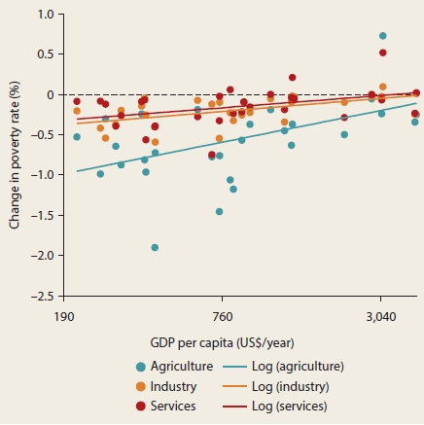
Advantage of agriculture in reducing poverty declines with development
As countries develop, ag focus shifts from staples, smallholders, self-sufficiency to
high value, economies of scale and commercial
Notes:
Structural transformation is as much about within sectoral productivity growth as it is about cross-sectoral labor reallocation →increase agricultural productivity to get out of agriculture
Source: Ivanic and Martin 2018.
Note: Figure shows single-country simulations of the poverty change from a sectoral productivity increase equal to 1 percent of GDP.

Slide 32
Agriculture in Africa is well-positioned
High food demand (much still staples)
High food prices (70% of 2008 peak, 40% real terms)
Agricultural policy and trade environment supportive
Good agroecological potential
But…
Low productivity & food consumption is increasingly met by imports, both for cereals—which are both produced and consumed by the poor—and higher-value products.
Not all agriculture is equally poverty reducing: continuing importance of staples and commercial smallholders
Notes:
Africa’s food import bill tripled over the past two decades (US$ 30 Billion)
Africa’s relative rate of assistance (RRA) to agriculture—a comprehensive measure of domestic policy bias against agriculture over nonagriculture—steadily increased from between −40 percent and −50 percent (indicating strong bias against agriculture) in the early 1980s, to between −5 percent and −10 percent in the late 2000s (Janssen and Swinnen 2016).7 This dramatic improvement is largely on account of the substantial decline in export taxes on industrial crops (cocoa, coffee, cotton, tea, and rubber) and fruits and vegetables
More recently, the nominal rate of protection (NRP) for staples—a measure indicating domestic output price support—has also been edging up across countries in response to the food price crisis and to stimulate import substitution
The 2003 Maputo Declaration on Agriculture and Food Security, was reaffirmed in the 2013 Malabo Declaration on Accelerated Agricultural Growth.
Staples – important for the poor (food security), broader multiplier effects, urban food remains relative expensive and opens new markets, import substitution

Slide 33
Much labor tied up in staples
Employment and income generated from meeting Tanzania’s food demand in a year
Expected change in labor (person days, ‘000)
Wheat and rice 5,471
Other grains 3,413
Roots and tubers 3,547
Pulses 4,246
Oilseeds 708
Vegetables 1,654
Gross income per grower
(USD)
Wheat and rice $31
Other grains $2
Roots and tubers $11
Pulses $3
Oilseeds $10
Vegetables $50
Notes:
Table 3.1
Source: Tschirley et al. 2017.
Note: ha = hectares; — = not available.
Table shows projected changes in labor needs, by crop, following rising demand from increased income and dietary change one year ahead.
Imports are netted out (assuming constant import shares); prices, investments or technology, and the structure of landholdings
and labor productivity are held constant. The projections represent the distribution of short-run employment and income opportunities at the farm level from rising food demand engendered by one year’s income growth.

Slide 34
Inclusive ag value chain development (VCD)
Overcome input, factor & output market constraints.
Outgrower schemes.
Participation increases productivity & income.
But typically not the poorest that participate.
Market power and concentration.
Strengthen producer organizations (challenging).
Manage medium/large scale production (if needed for ensure market access/economies of scale) → the poor can benefit thru labor market
Notes:
Value Chain Development (VCD) is solution for integrated approach
Institutional coordination between the different stakeholders within marketing channel
Inclusive VCD include poor producers within commercial VCD
Empirical evidence on contract farming
Critical factors determining inclusiveness
Risks and shocks in (new) output markets (e.g. changing consumer preferences)
Market concentration and bargaining power of farmers
#2: VCD
Opportunities – spillovers in output (higher prices)/input (mechanization) markets, technology transfer
Challenge – employment generation, ag wage labor conditions (child labor), technology transfer effective, typically not the poorest that participate

Slide 35
Public support to smallholder staple crop productivity
VCD more difficult for staples than nonstaples.
Insufficient value addition hinders contract compliance.
Better potential if cash crop (rice, teff) or use for animal feed or industrial use (beer) (rice in CIV; maize)
Especially public investment in public goods needed & is still limited (3% of govt spending).
Ag RD&E (new extension models).
Irrigation and land/soil fertility management.
Access to finance.
Livestock development support.
Rural transport and infrastructure (high AEP areas).

Slide 36
Moving off the farm
Landscape of microenterprises

Slide 37
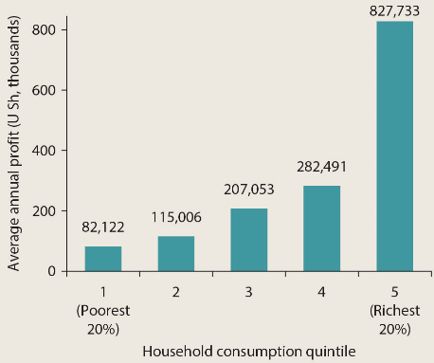
Off the farm work
Uganda household enterprises
Household enterprises dominate
Diversification in rural areas
1/4 – 1/3 of off-farm work is in the agro-food system
Large dualism and concentration of microenterprises
Notes:
Sources: World Bank Africa Poverty database and International Income Distribution Database (I2D2).
Note: Figure represents data from 40 African countries.
“Opportunity” “constrained gazelles,” “transformational” enterprises, or “improvement-driven” businesses. On the other hand, small-scale informal enterprises may be driven by necessity as the lack of wage jobs and formal unemployment insurance push people to jump-start self-employment as a survival strategy
Informal “household enterprises”—a business activity owned and operated by one or more household members with no hired labor—are the most common

Slide 38
Microenterprise potential?
Reduces seasonal underemployment; risk coping; finances farm investment.
Rapid growth in formal wage jobs cannot absorb large number of new labor market entrants.
Employment generation through entry, not expansion
Notes:
Low barriers to entry and exist make HHE attractive to the poor.

Slide 39
“Supply” side
“Capital-centric” and “Skills-centric” approaches, sometimes bundled.
Mixed evidence of impact, usually better when bundled; graduation programs (cash +).
Do not stand in the way (representation).
Still a lot to learn, especially about agro-related microenterprises and rural programs.
Notes:
Northern Uganda: after 9 years, there were no differences between those with and without the grants, employment, earnings, and consumption
Informal household enterprises:
-

Slide 40
“Demand” side
Growing towns more important than growing cities for poverty reduction.
- Global & country evidence.
- Deterrence of distance outweighs attraction of wealth.
Town development : connectivity; urban infrastructure (electricity) and services (attract firms and talent); fiscal arrangements.
Regional integration/border towns (food).
Digital technology to increase earnings for self employed (customer connection, mobile money).
Notes:
Country evidence: India, Mexico, Tanzania
Proximity facilitates access for a number of reasons - lower cost of migration (transport, settling/house, jobs searching and match) and return (safety net); facilitates first move and ladder migration

Slide 41
Action area 3.
Manage risk and conflict

Slide 42
Risk landscape
Risk & conflict increase poverty and keep people poor:
- Large effect not just when bad events occur, but also the costly behavior in anticipation of (uninsured) risk.
Risks in Africa are higher and more covariate
Dominant livelihoods are much riskier.
Health systems are weaker.
Conflict is more prevalent and rising
Climate change adds further uncertainty (heat waves, floods, droughts)

Slide 43
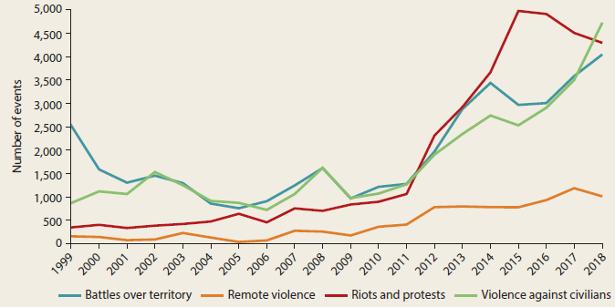
Conflict events on the rise
Notes:
The scale of the displacement crisis in Africa is large. As of mid-2018, the region hosted 35 percent of the global displaced population (not all due to conflict), accounting for approximately 24 million people, which is larger than the populations of 36 out of 48 African countries. Of the top 20 countries in the world in terms of displaced populations being hosted, 7 are in Africa.
Figure 5.7
Source: Armed Conflict Location and Event Data Project (ACLED) database: https://
www.acleddata.com/.
‘Remote violence’ refers to events in which the tool for engaging in conflict did not require
the physical presence of the perpetrator. These include bombings, Improvised Explosive
Device (IED) attacks, mortar and missile attacks, etc. In events classified as ‘Remote
violence’, a spatially removed group determines the time, place and victims of the attack.
Remote violence can be waged on both armed agents (e.g. an active rebel group; a military
garrison) or on civilians (e.g. a roadside bombing).

Slide 44
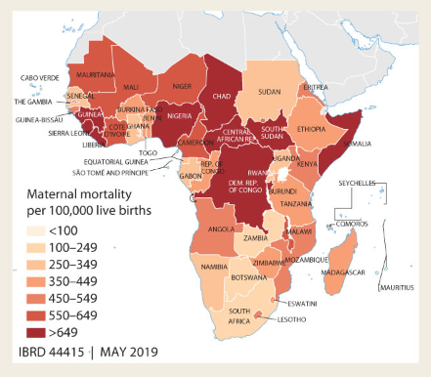
Maternal morality is highest in the world
Notes:
Map 5.1e
Source: World Development Indicators database, maternal mortality ratio

Slide 45
Covariate risks challenges coping
Covariate shocks make strategies used to manage risk by poor households often ineffective.
Households rely on savings, family, and friends.
Financial market development is weak so there is a lack of effective insurance.
Slow, poorly targeted humanitarian assistance predominates.

Slide 46
Tools to better manage risk and consequences
Strategies to reduce exposure not widely used.
Saving, insurance, and safety nets to protect households.
But financial markets remain poorly developed and limited social protection programs (though growing)
Humanitarian support needs to be more timely, predictable, better targeted and more focused on using exiting social protection systems.
Households need a mix of tools to manage shocks.
Notes:
Cost of prevention often lower than cost of managing the event
There are very few shock responsive safety nets in place in the region. Many safety nets in Africa are established in the aftermath of disaster or conflict a but few countries have safety net programs that can scale quickly to meet the additional needs of shocks. Programs are increasingly being designed with this idea in mind. In Ethiopia, the Productive Safety Net Program includes a 5 percent contingency financing that can be used to increase the scale of the program in the event of a drought or food price increase.
Households need a mix of tools to manage shocks. Small, frequent shocks such as moderate rainfall shortages or short-term illnesses, are better managed with savings and transfers to households when they are too poor to save. Larger, less frequent shocks such as a drought or severe illness, will require insurance and scalable safety nets for households that are too poor to purchase insurance. The appropriate mix of risk management tools will vary across households Investments in both financial markets and the safety net systems are needed. See also chapter 2 in Protection for All (Truman et al. 2019).

Slide 47
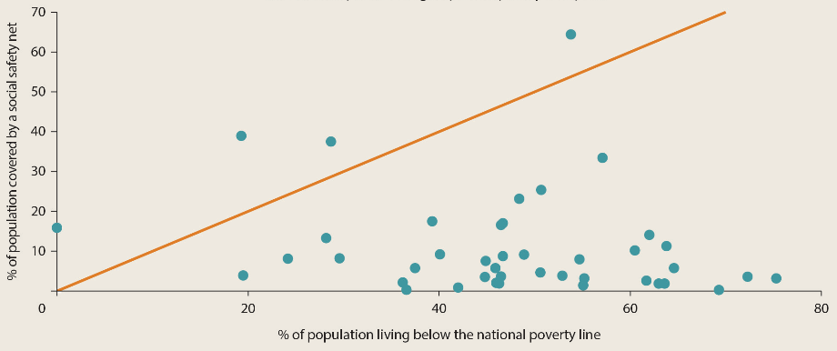
Insufficient scale of safety nets
Notes:
Source: Beegle, Honorati, and Monsalve 2018. a.
This figure considers regular programs (not emergency programs) that are still being implemented and for which information on the year of the launch is available.
b. Social safety net coverage rates are approximated by summing the number of direct and indirect beneficiaries of cash transfers, food-based transfers, and public works programs
only.
The beneficiaries of the other six program types (social pensions, school feeding, emergency programs, health care and education fee waivers, and other programs) are not included because their beneficiaries are more likely to overlap with those in other programs, which would result in overestimated coverage rates. The leftmost circle designates Mauritius, which records a poverty rate of less than 1 percent.

Slide 48
Address before shocks occur
Public: Perverse political incentives that constrain ex-ante government action; also lack of fiscal space, capacity, and coordination costs.
Private: Behavioral constraints that limit household investment: scarcity-induced focus on present, resignation, ambiguity aversion. Induce households to make this a priority now—e.g. making tools free initially and strong outreach is needed.
Notes:
Mandates and care of chronic conditions can help overcome adverse selection in health insurance.
Providing a clear regulatory framework to reduce investment uncertainty and public provision of some of the fixed investments that need to be undertaken can help encourage market development
China’s agricultural microinsurance market grew to be the second largest agricultural insurance market in the world in 2008 because of government support and subsidies, and in fact 63 percent of agricultural insurance markets in middle- and low-income countries receive premium subsidies
Some spending could be realigned to more effectively reduce risk. For example, irrigation could become a higher priority in agriculture spending to increase both agricultural growth and the stability of agricultural incomes
Index-insurance products have proven that the index on which they are based is of sufficient quality to make this a useful insurance product for many farmers in Africa

Slide 49
Technological innovation and information systems
Foster technological innovation.
Cheaper technology for water management (solar)
Financial innovations (mobile money, index insurance).
Invest in information systems
Many shocks are slow onset & early warning systems can pay off.
Better information basis for risk modeling.

Slide 50
Insights from a case study in Kagera, Tanzania
Action area 4.
Mobilize resources for the poor

Slide 51
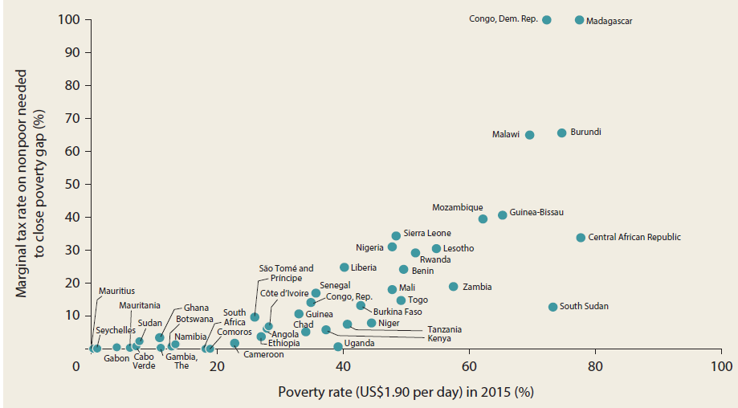
High levels of poverty implies high tax rates to cover needs
Notes:
Figure 6.1
Source: World Bank calculations.
Note: In the figure, the marginal tax rate on the nonpoor is capped at 100 percent.

Slide 52
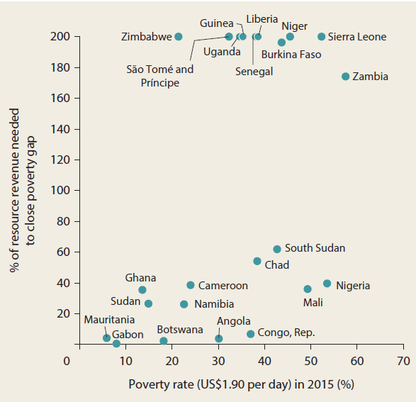
Resource revenue won’t be sufficient
Notes:
Figure 6.2
Source: World Bank elaboration.
Note: In the figure, the share of natural resource revenue is capped at 200 percent. Data are from
23 out of 48 African countries with natural resource revenues and nonmissing data on the level of
resources.

Slide 53
Severely constrained fiscal space
Low domestic revenue-to-GDP ratios.
VAT and indirect taxes dominate, but tend to hurt the poor.
ODA still critical in poorest countries: more than 8% of GDP for half of low-income countries. But declining.
Debt concerns are back.
Notes:
In several African countries, tax revenue to GDP less than 13%, which is tipping point below which executing basic state functions and sustaining development becomes problematic); average is 14%.
Try to reduce the reliance on VAT and other indirect taxes (which are probably efficient and effective), but hurt the poor.
Other indirect taxes are : trade taxes at the port and excise taxes (fuel taxes)
Direct taxes: personal and corporate income

Slide 54
On the spending side
Spending in “pro-poor’ sectors has a mixed track record: education improving but health, WASH, and agriculture below targets, and scale of social protection falls short.
Low spending efficiency.
Systematically lower spending & spending efficiency on education and health in resource rich countries
High fertility further suppresses impact of spending.
Notes:
Many measures to tackle poverty are embedded in the provision of basic services and direct transfers (for example, schools, clinics, or cash transfers that help to build human capital and manage risks) as well as in the sectoral allocation of public spending toward sectors more likely to benefit the poor, such as agriculture.
As such, tracking pro-poor spending is usually sectorally focused, even though, importantly, within sector spending choices can also have quite different effects on poverty.
Education for all target: 4-6% of GDP, which several are missing (despite improvement)

Slide 55
Collect more - Increase revenues
Low domestic revenue-to-GDP ratios.
Heavy reliance on VAT, often hurts the poor
Continue to invest in improved compliance.
Focus on corporate taxes and global agenda.
Transfer (mis)pricing is the primary way through which illicit financial flows (the largest source of missed revenue for African countries) leave countries.
Focus on more property tax collection.
Notes:
Try to reduce the reliance on VAT and other indirect taxes (which are probably efficient and effective), but hurt the poor.
See also Ch6 in Protection for All (Truman et al. 2019).

Slide 56
Spend better - revisit subsidies (again)
High subsidies expenditures, yet regressive or have little impact on poverty.
The lack of impact from agric subsidies gets magnified because they crowd out other investments that could raise productivity.
Compensate affected groups to preempt opposition, develop strong communication on the need for reforms and trust in the ability of government to handle competing interests.
Address fertilizer cartels issue.
Notes:
Spending on public vs private goods (subsidies)

Slide 57
Spend better – sector efficiency and equity
Spend on public, not private goods - revisit subsidies (fuel and fertilizer)
Address poor efficiency of spending in health and education (i.e. low quality).
Improve access to information
But also right conditions to work will help teachers and health staff deliver
As well as inequity within sector
More geographically targeted spending
Systematically lower spending & spending efficiency on education and health in resource rich countries

Slide 58
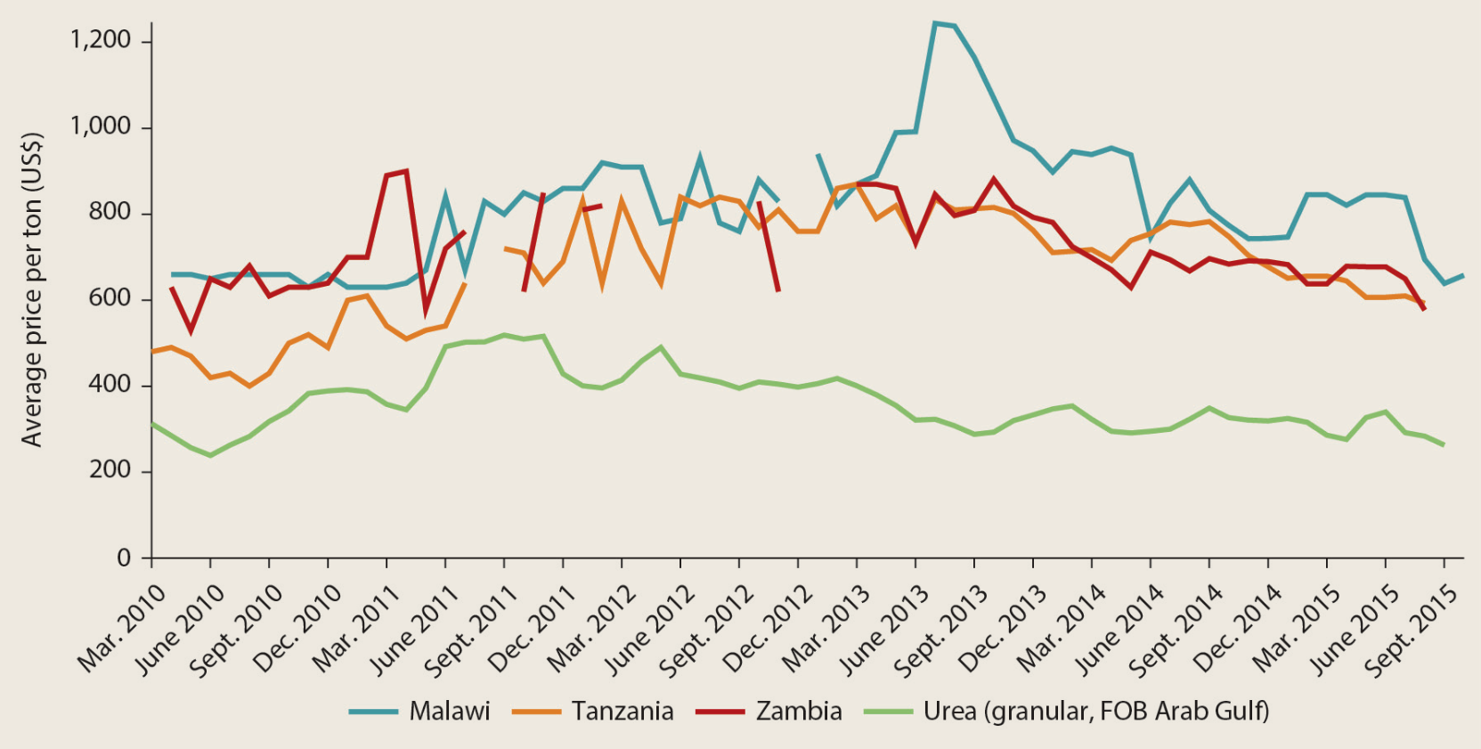
Gap in local and world urea prices
Notes:
Figure B6.5.1
Source: Roberts 2017.
Note: FOB = free on board.

Slide 59
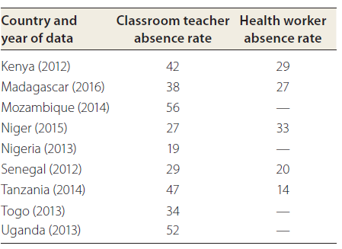
Absent service providers at schools and health clinics
Notes:
Source: World Bank Service Delivery Indicators country reports, http://
www.sdindicators.org.
Note: — = not available.

Slide 60
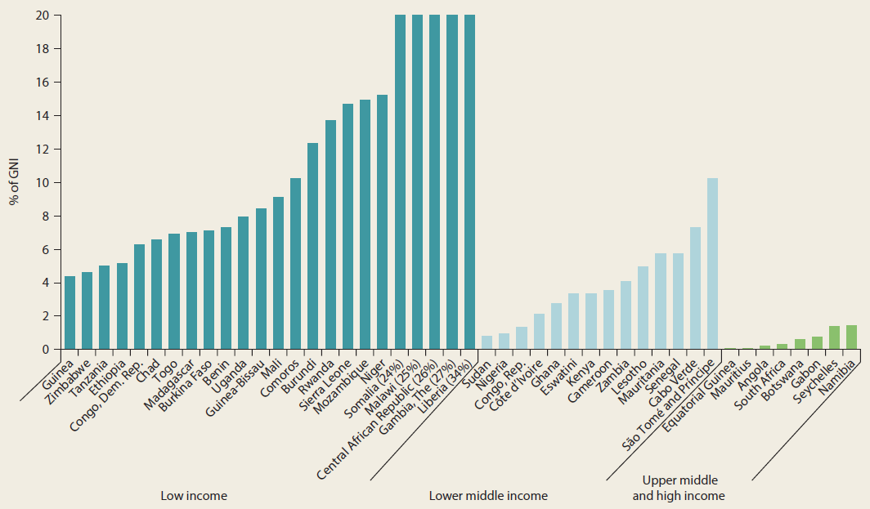
ODA remains imperative for many to fill the poverty financing gap
ODA as a share of countries’ gross national income
Notes:
Source: Organisation for Economic Co-operation and Development (OECD) 2017 data, https://data.oecd.org/.
Note: GNI = gross national income; ODA = official development assistance. ODA data do not include aid inflows from international charities, international nongovernmental
organizations, and private donations.
More than 8% of GDP for half of low-income countries

Slide 61
Four primary action areas
1) Address High Fertility
2) Leverage the Food system, on and off the farm
3) Address Fragility
4) Focus on Fiscal side

Slide 62
THANK YOU!
Read more at :
https://openknowledge.worldbank.org/handle/10986/32354

