Slide 1
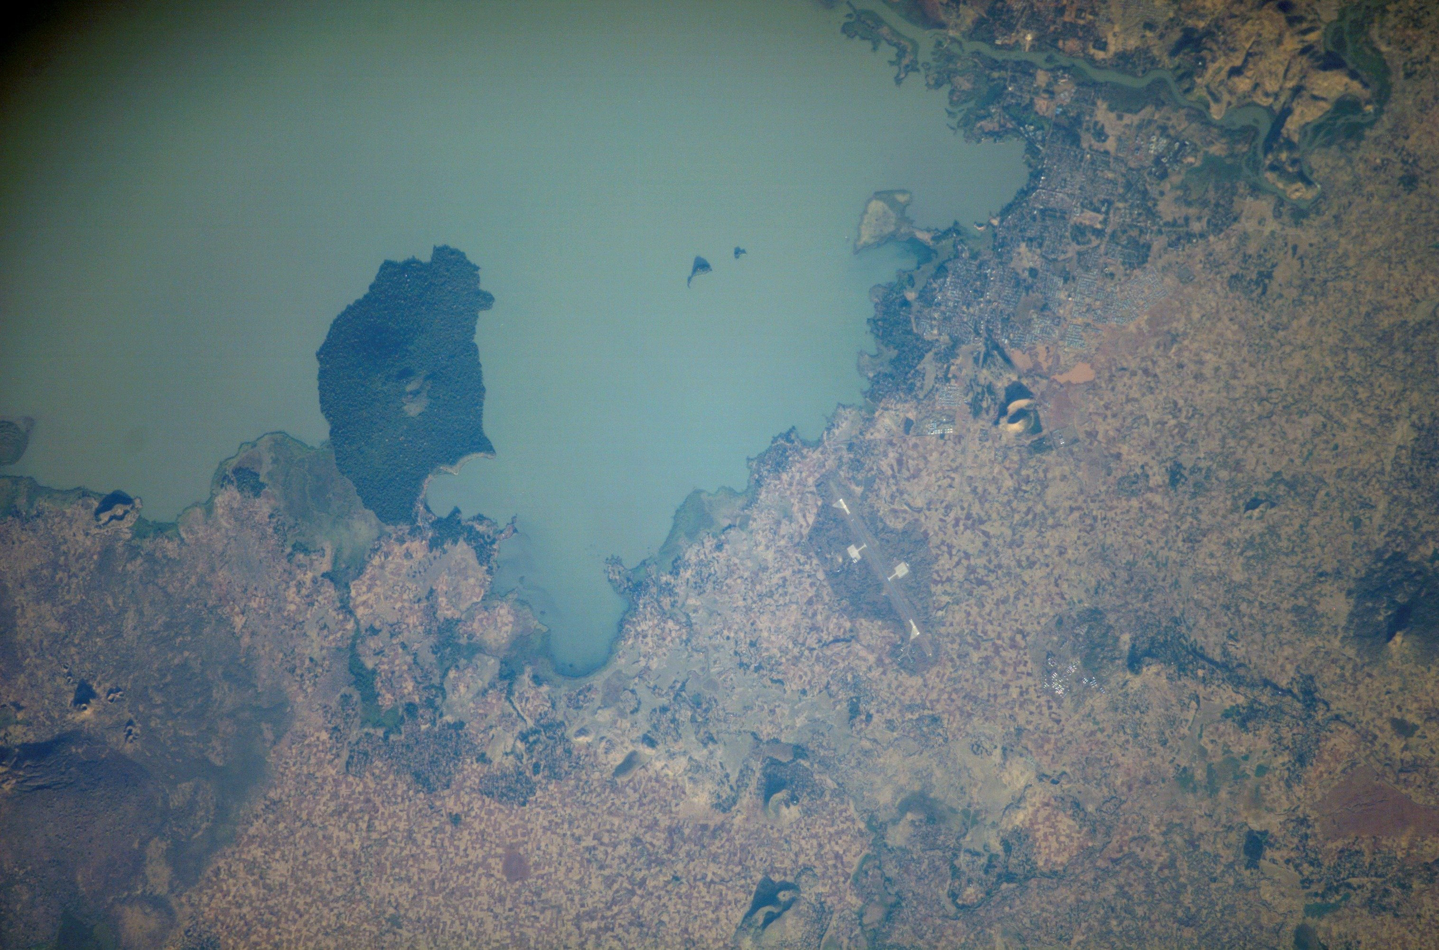
Dr. Marleen Dekker
Coordinator Secretariat INCLUDE Platform
African Studies Centre

Slide 2
Knowledge for Policy
Five Knowledge Platforms for development cooperation on main policy themes initiated by Dutch MFA
Within platforms: academia, civil society, private sector and policy-makers jointly develop a more coherent knowledge agenda by:
- Developing knowledge
- Mapping and disseminating knowledge
Influencing policy-making

Slide 3
INCLUDE Knowledge Platform
Three themes:
Productive Employment: Poverty reduction and social inclusion are linked to economic development through the creation of jobs of sufficient quality
Social Protection: Social protection plays multiple roles in achieving inclusive development in Sub-Saharan Africa, notable through the productive participation of the poor. However, national governments lack the capacity or political will to introduce comprehensive social protection programmes
Strategic Actors: The effective implementation of inclusive policies is not simply a matter of formulating the right policies, but rather about reaching actors with political power or capacity and encouraging them to implement those policies

Slide 4
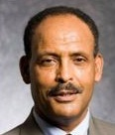

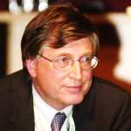
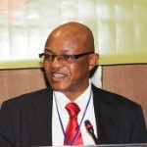
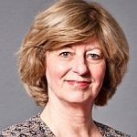
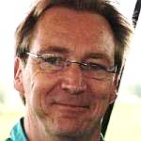

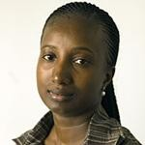
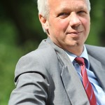
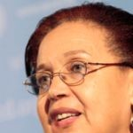

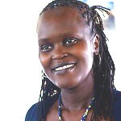

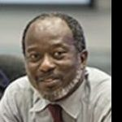
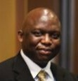

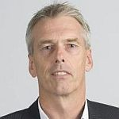
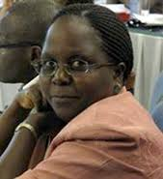
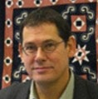
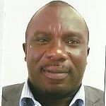
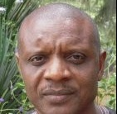
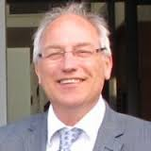
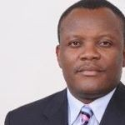
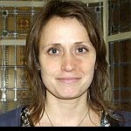
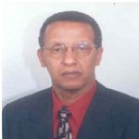
Rolph van der Hoeven
Lemma
Senbet
Adriano Nuvunga
William Lyakurwa
Isa Baud
Robert-Jan Scheer
Dennis Arends
Fatoumata Lamarana Diallo
Roel van der Veen
Maggie Kigozi
Marina Diboma
Sarah Ruto
Yaw Ansu
Basil Jones
Erwin Bulte
Rob Bijl
Sarah
Ssewanyana
Ton Meijers
Ebrima Sall
Ton Dietz
Nicholas Awortwi
Désiré Assogbavi
Josine Stremmelaar
Assefa Admassie

Slide 6
Knowledge products/activities to influence policy
Valorisation and uptake new knowledge
2. Valorisation and uptake existing knowledge
3. Building knowledge communities around themes

Slide 7
1. Valorisation and uptake new knowledge
WHO?
Secretariat: Lead
Research Groups: Active participation
Platform members: Active engagement
Policy makers/practitioners: Time and feedback
KNOWLEDGE PRODUCTS:
Factsheets
Activities updates
One pagers with preliminary findings
Policy recommendations
Pitches

Slide 8
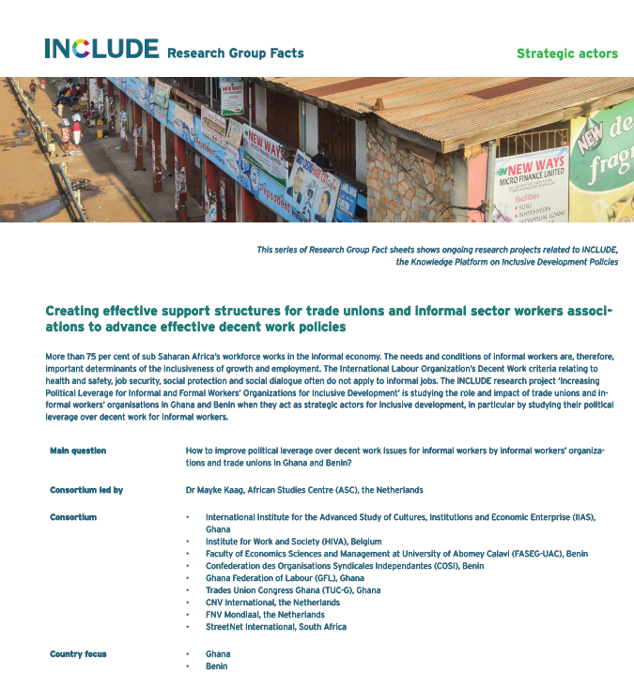

Slide 9
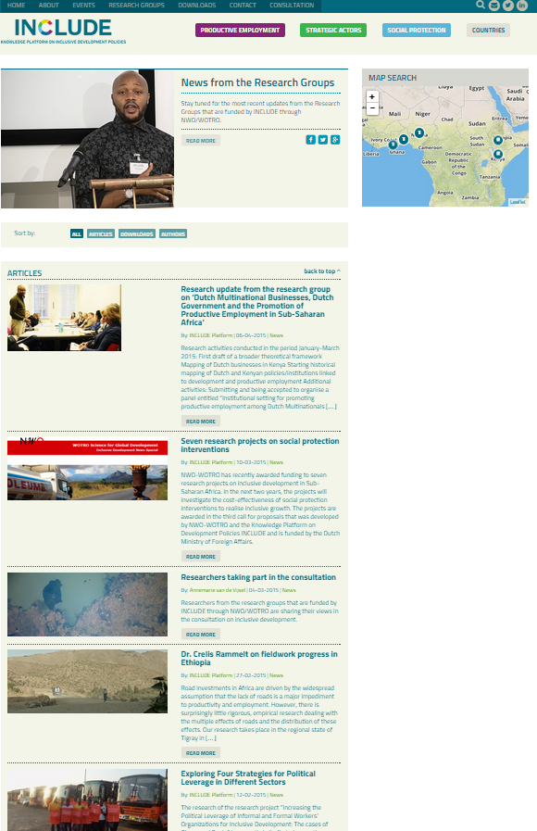

Slide 10
2. Valorisation and uptake existing knowledge
WHO?
Secretariat: Lead
Research Groups: Sources of information + feedback
Platform members: Sources of information + feedback
Policymakers/practitioners: Time and feedback
KNOWLEDGE PRODUCTS:
Uploading existing publications and resources on INCLUDE website
Alert service
Mappings of existing knowledge around a specific theme
One-page summaries of existing research and initiatives
Thematic reviews linking the three themes to the research projects
Synthesis articles
Book reviews
Concept notes: (productive employment with full links)
Notes:
Uploading existing publications and resources on INCLUDE website > EXAMPLE
Expert opinions
Mappings of existing knowledge around a specific theme; connecting Africa alerts and mapping documents
One-page summaries of existing research and initiatives > 2 EXAMPLES (YOUTH EMPLOYMENT; FEMALE ENTREPENEURSHIP)
Thematic reviews linking the three themes to the research projects
Synthesis articles > EXAMPLE
Book reviews > EXAMPLE

Slide 11
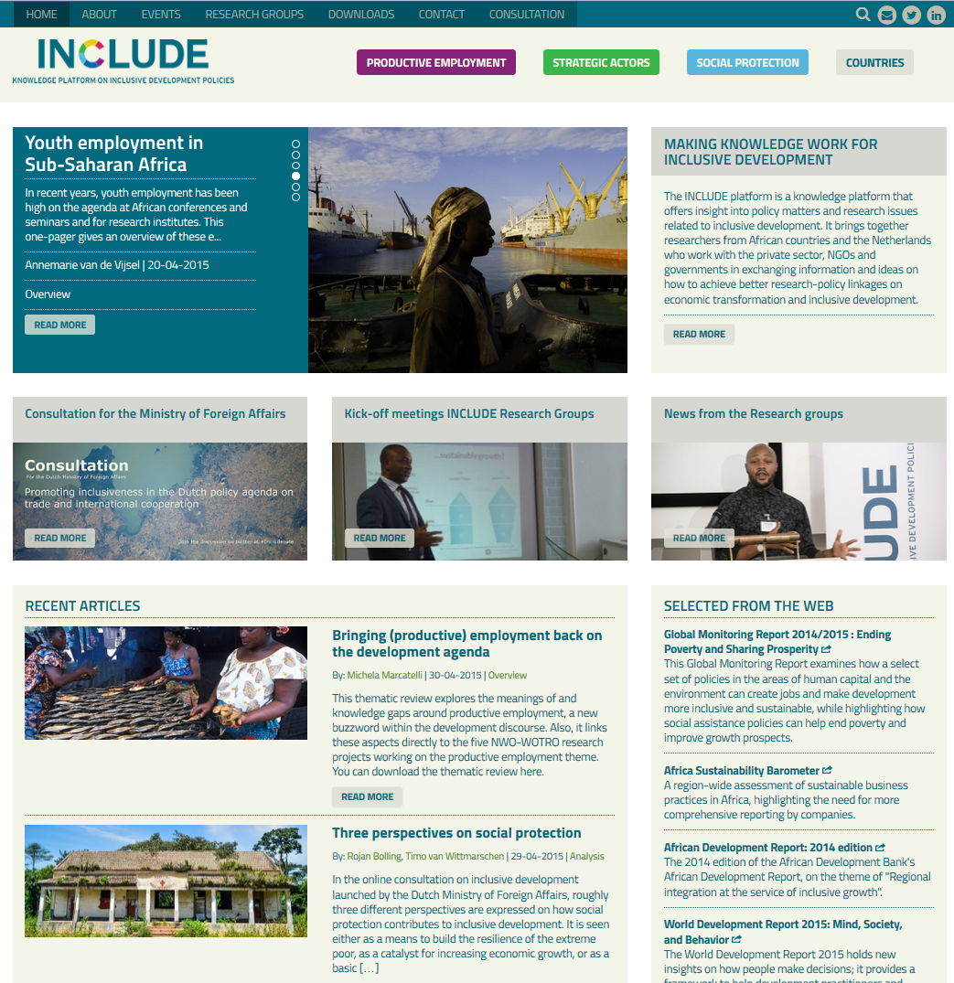

Slide 12
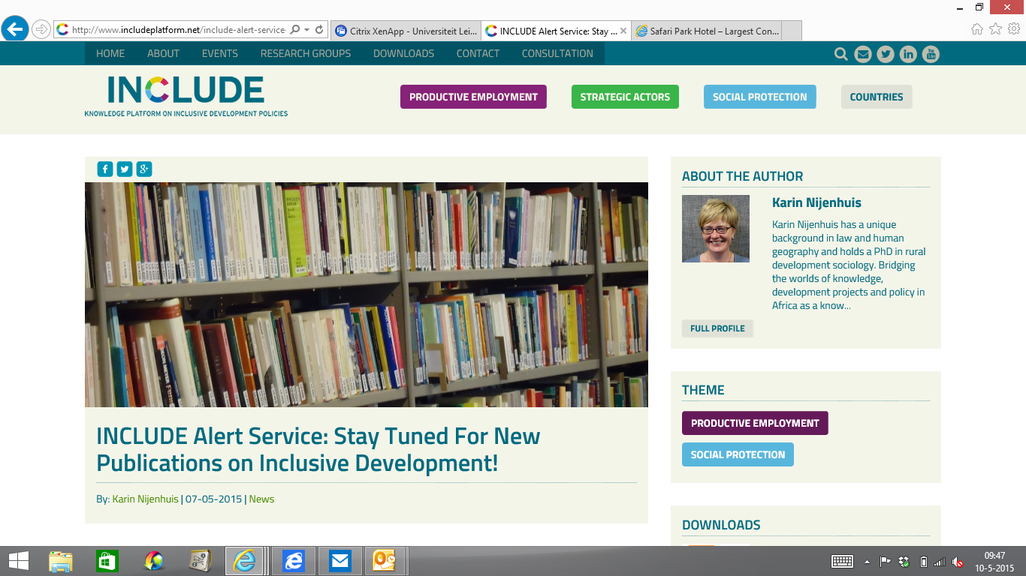

Slide 13

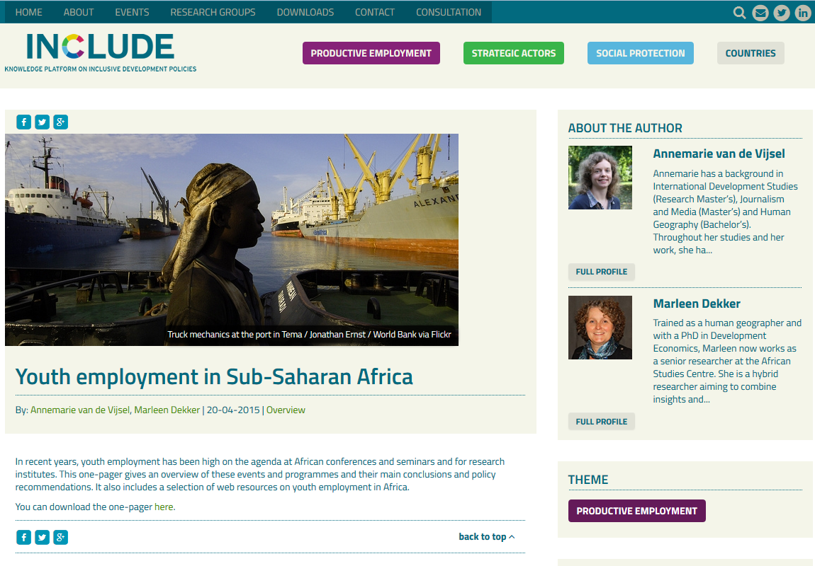

Slide 14
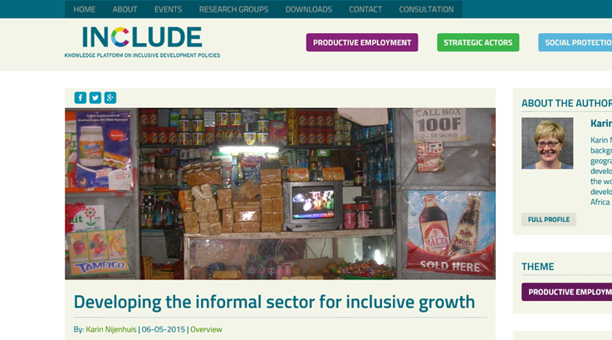
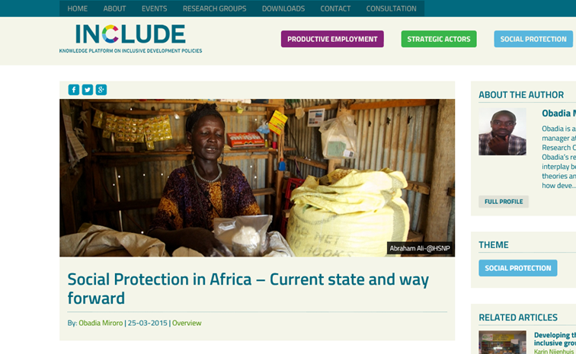
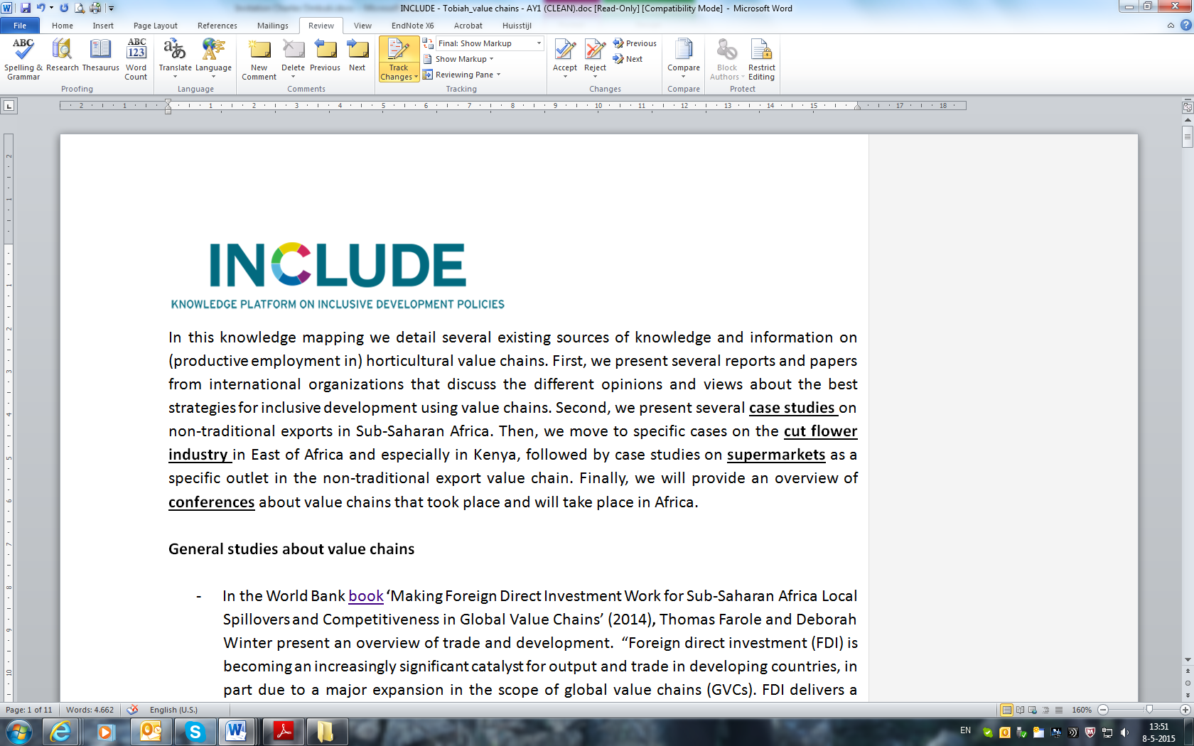

Slide 15
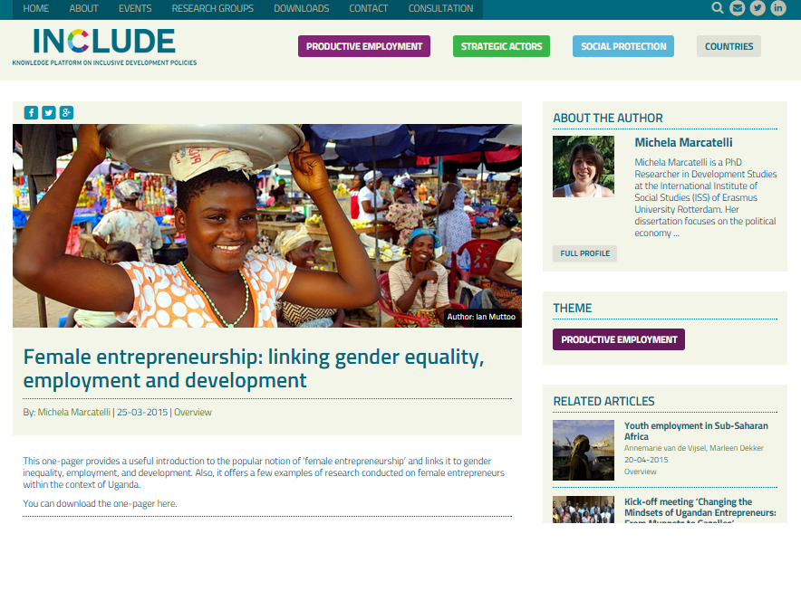

Slide 16


Slide 17
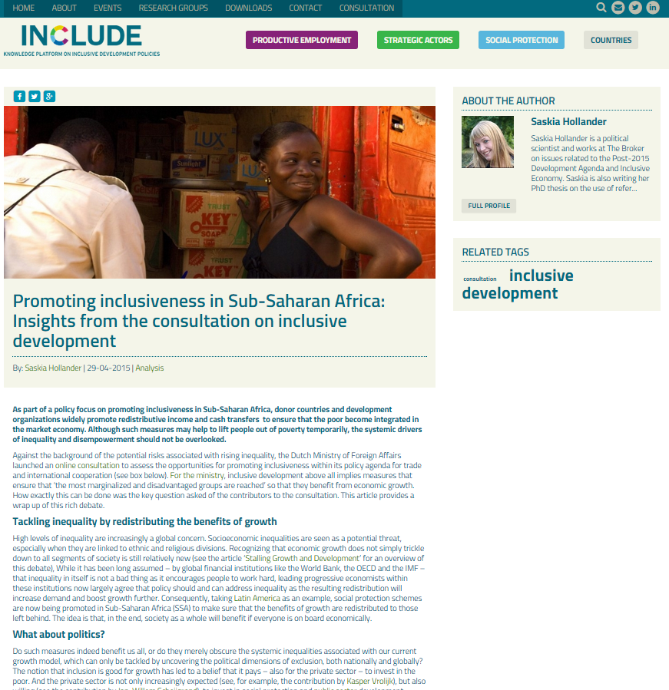

Slide 18
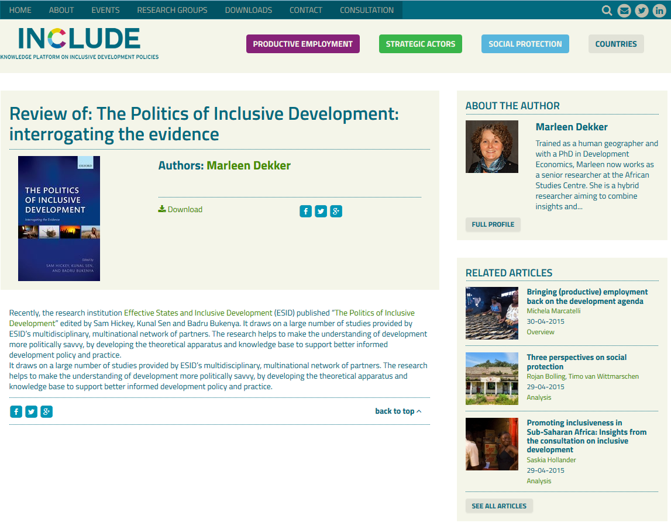

Slide 19
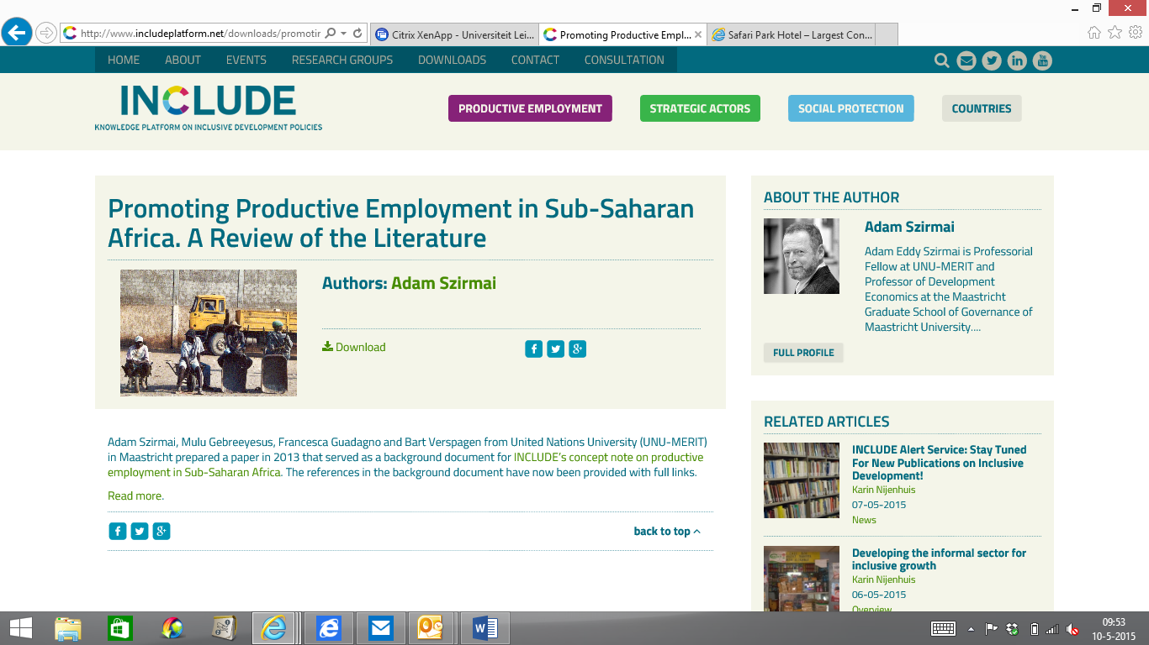

Slide 20
3. Building knowledge communities
WHO?
Secretariat: Lead with members
Research Groups: Active engagement
Platform members: Active engagement, lead engagement African policymakers
Policymakers/practitioners: Time and feedback
KNOWLEDGE PRODUCTS:
Newsletter and social media
Events calendar
Stakeholder mappings of policy and knowledge stakeholders in the countries of research
Space for online debate on website (consultation, expert opinions and online comments)
Relevant knowledge products on existing knowledge
Notes:
Newsletter and social media > EXAMPLE
Concept notes > EXAMPLE PRODUCTIVE EMPLOYMENT
Stakeholder mappings of policy and knowledge stakeholders in the countries of research
Space for online debate on website (through expert opinions and online comment, see also the consultation on inclusive development) > EXAMPLE

Slide 21

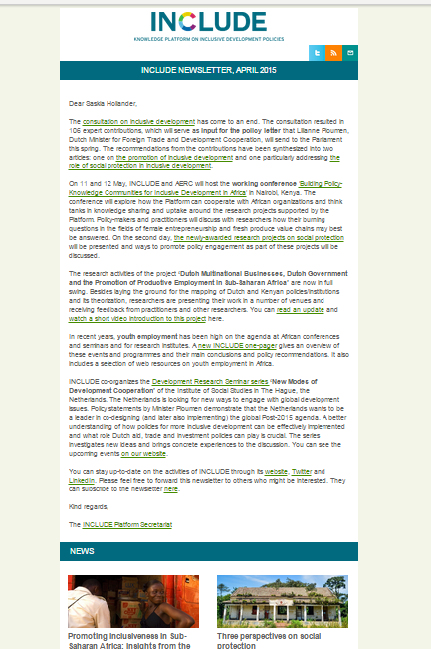

Slide 22
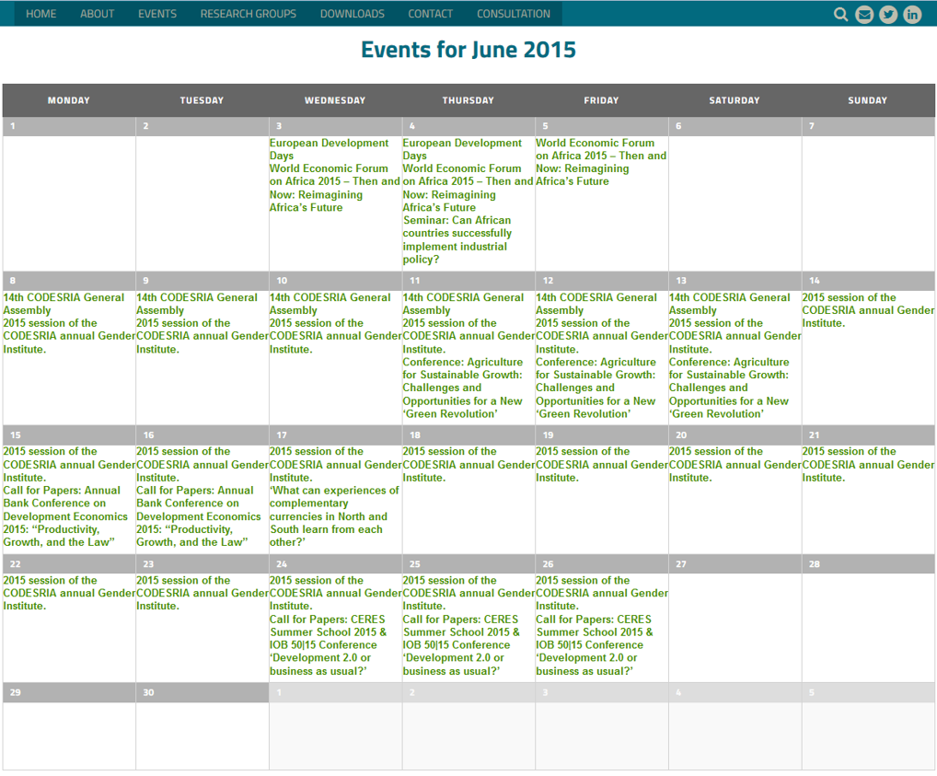

Slide 23
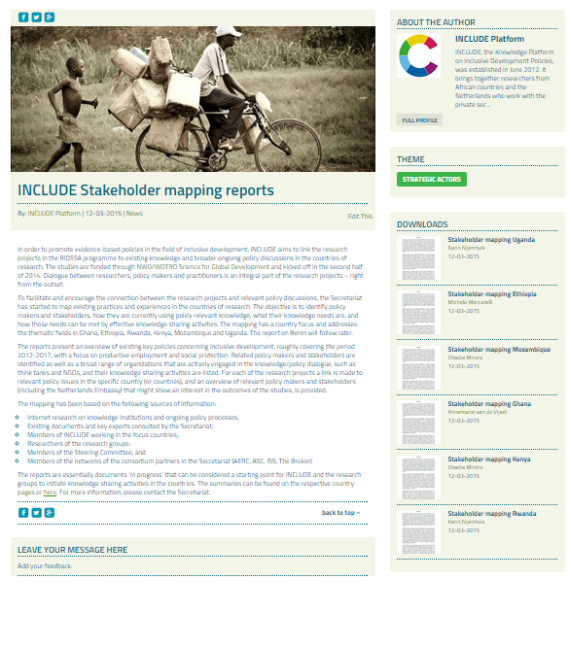

Slide 24
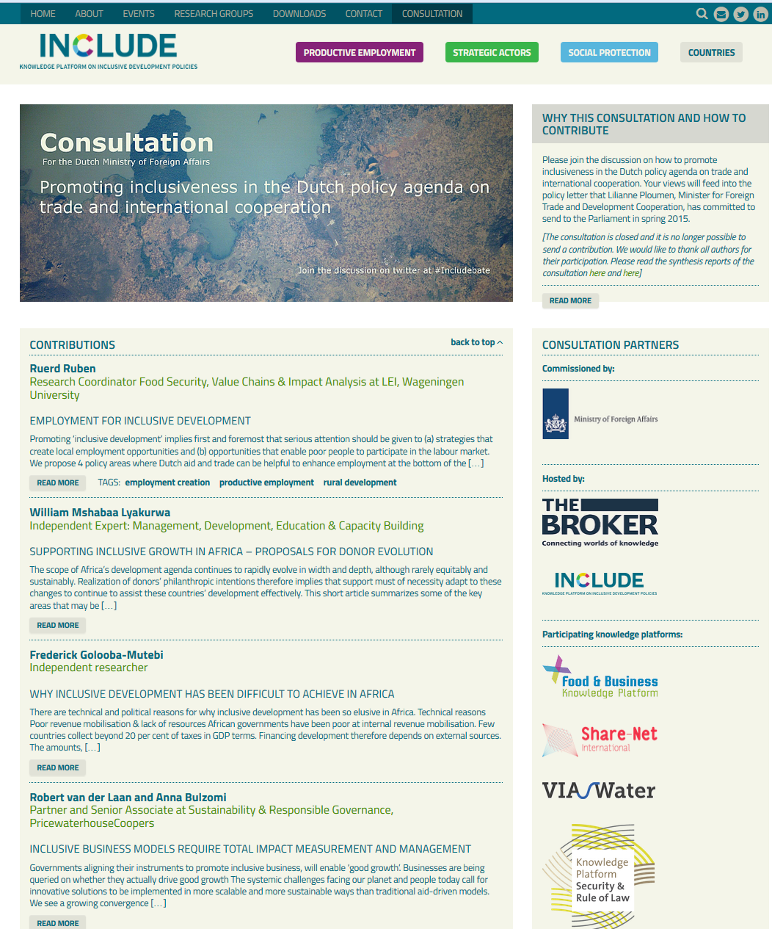

Slide 25
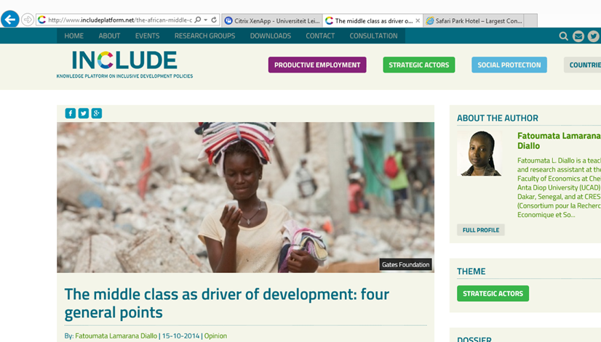
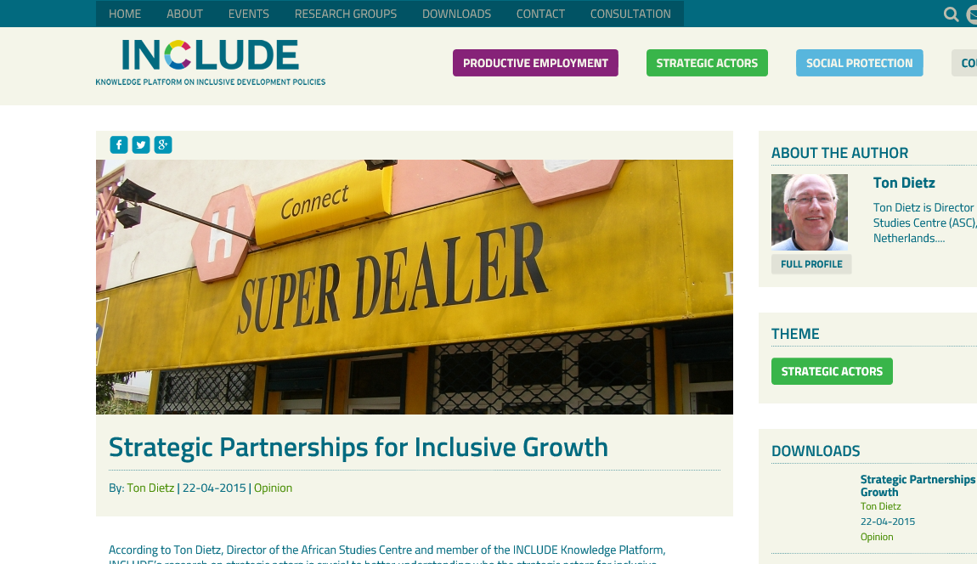
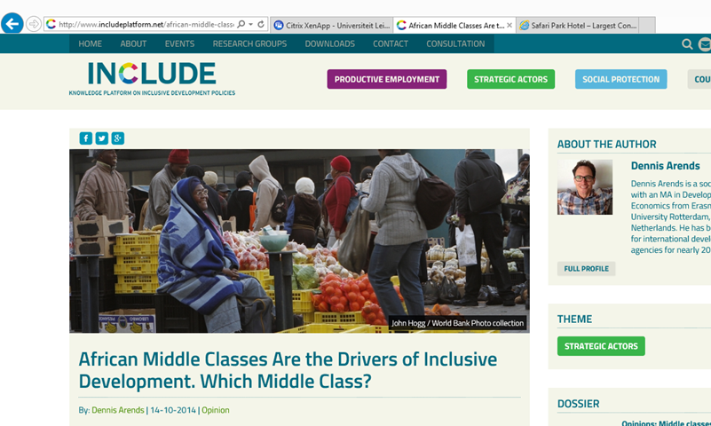
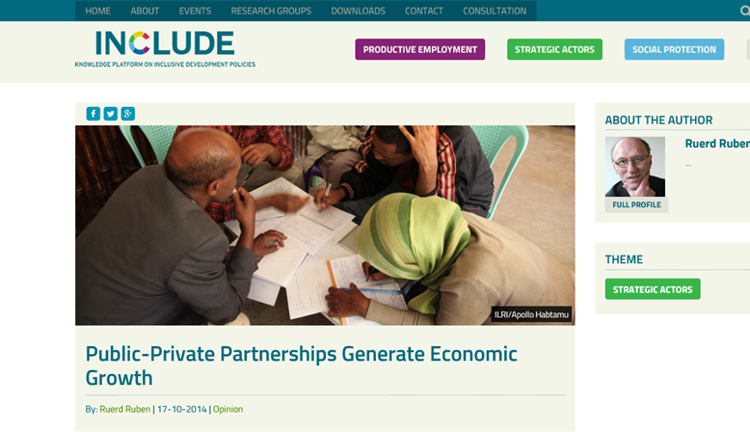

Slide 26
Thank you for your attention!

Slide 27
SHARE YOUR EXPERIENCE!
@includeplatform
# includeplatformmeeting

