Slide 1
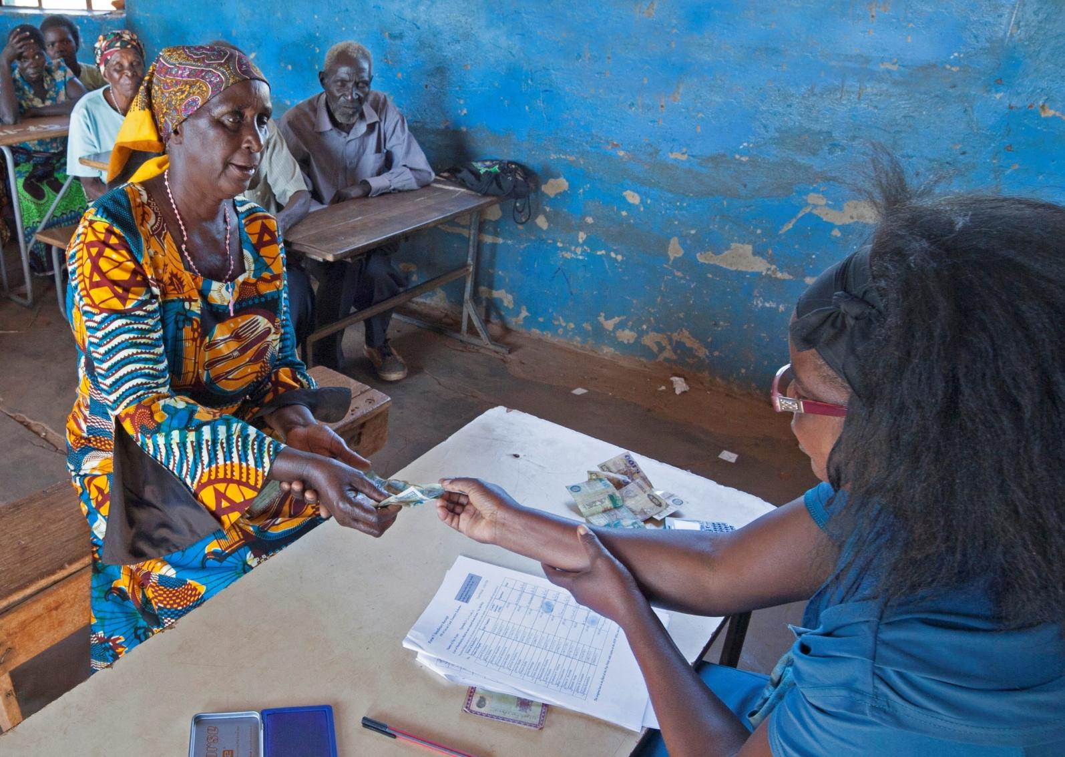
Social Cash Transfers in Zambia Impact and Policy context
Seminar on Social Protection
The Hague, Ministry of Foreign Affairs
23 June 2016
Paul Quarles van Ufford
UNICEF Zambia

Slide 2

PRESENTATION OUTLINE
Poverty and inequality
Social Cash Transfer program
Netherlands Government support for social protection
Social Cash Transfer impact evaluation
Policy and financing implications
Notes:
The storyline of the presentation is as that:
Poverty and inequality have remained high despite consistent economic growth over the past 10-15 years
Zambia’s policy response to poverty has until recently been fragmented, ineffective, and poorly targeted at households in extreme poverty
Zambia’s social cash transfer programme demonstrates a strong potential as a starting point for tackling poverty and deprivation
The programme has been scaling up recently, is positioned at the center of Zambia’s social protection policy, and further scale up is affordable

Slide 3
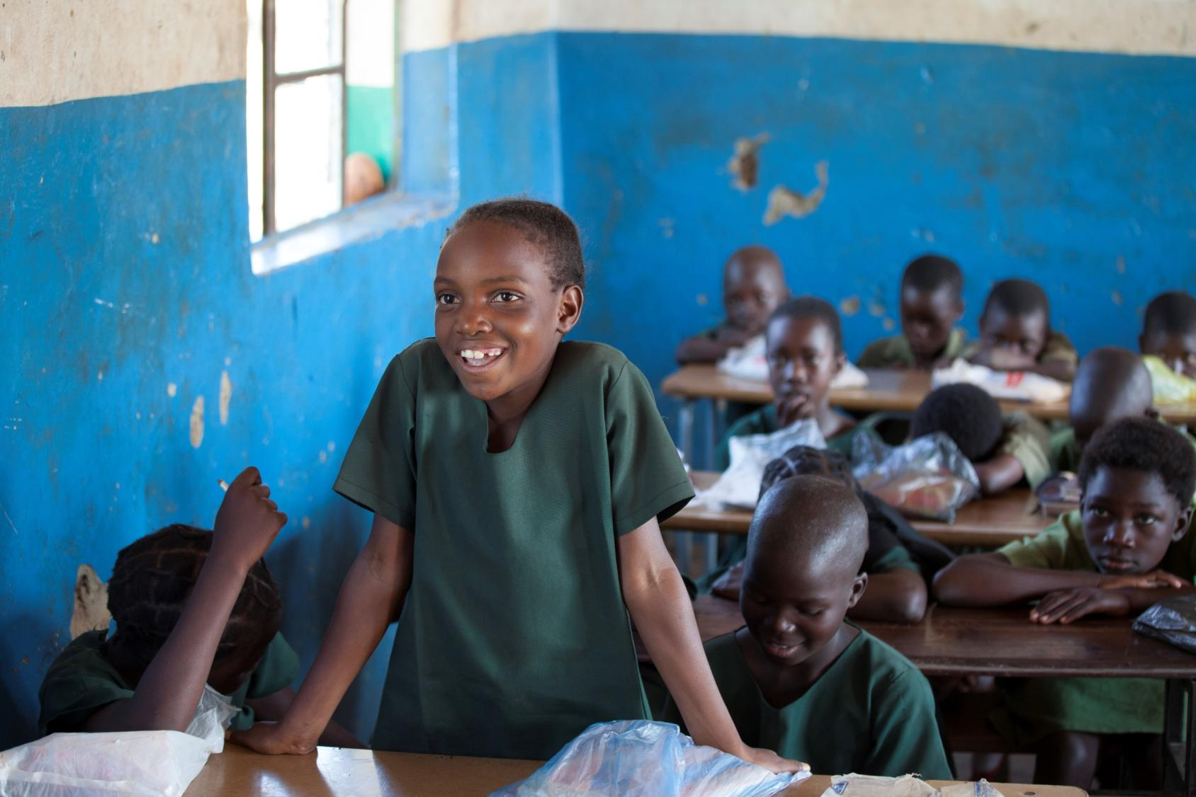
Poverty, inequality and HIV/AIDS in Zambia

Slide 4

POVERTY 2006 - 2015
Notes:
What does the slide show?
Fairly marginal reduction over 10-year period (characterized by consistent economic growth of > 5%)
Significant differences between rural and urban. Same decline in percentage points, higher relative decline in urban areas
Although difficult to see, the 2015 decline is driven by urban areas
What does the slide not show?
Decline in percentage points but increase in absolute numbers of poor persons - +500,000
What changed below the poverty line? We have not seen the figures on the poverty gap
What is the situation within urban areas? Poverty low overall but is it concentrated in certain areas of the cities?
The impact of the economic crisis which developed over 2015 (electricity; inflation mainly)
That poverty is related to age. Poverty is larger among children and among older persons. In 2010, poverty headcount among children was 65%
1.2 million people living with HIV (13% of the population)
21,000 new infections among adolescents and young adults

Slide 5
INEQUALITY 2010 - 2015
Notes:
How is wealth distributed in Zambia? Not very equally …
Overall inequality has increased significantly, and it is reflected in a major urban – rural gap (even though inequality is also high within urban and within rural areas
Zambia among the highest ranking countries globally when it comes to inequality. Economists agree that inequality is bad for growth. What does this mean for economic policy or social policy?
Will poverty eventually become a rural phenomenon?
If the gap did increase so significantly, what has happened, what is happening? Migration, young people, do we capture poverty and vulnerability well among this group – to what extent is it happening? What does it mean for social protection policy?

Slide 6
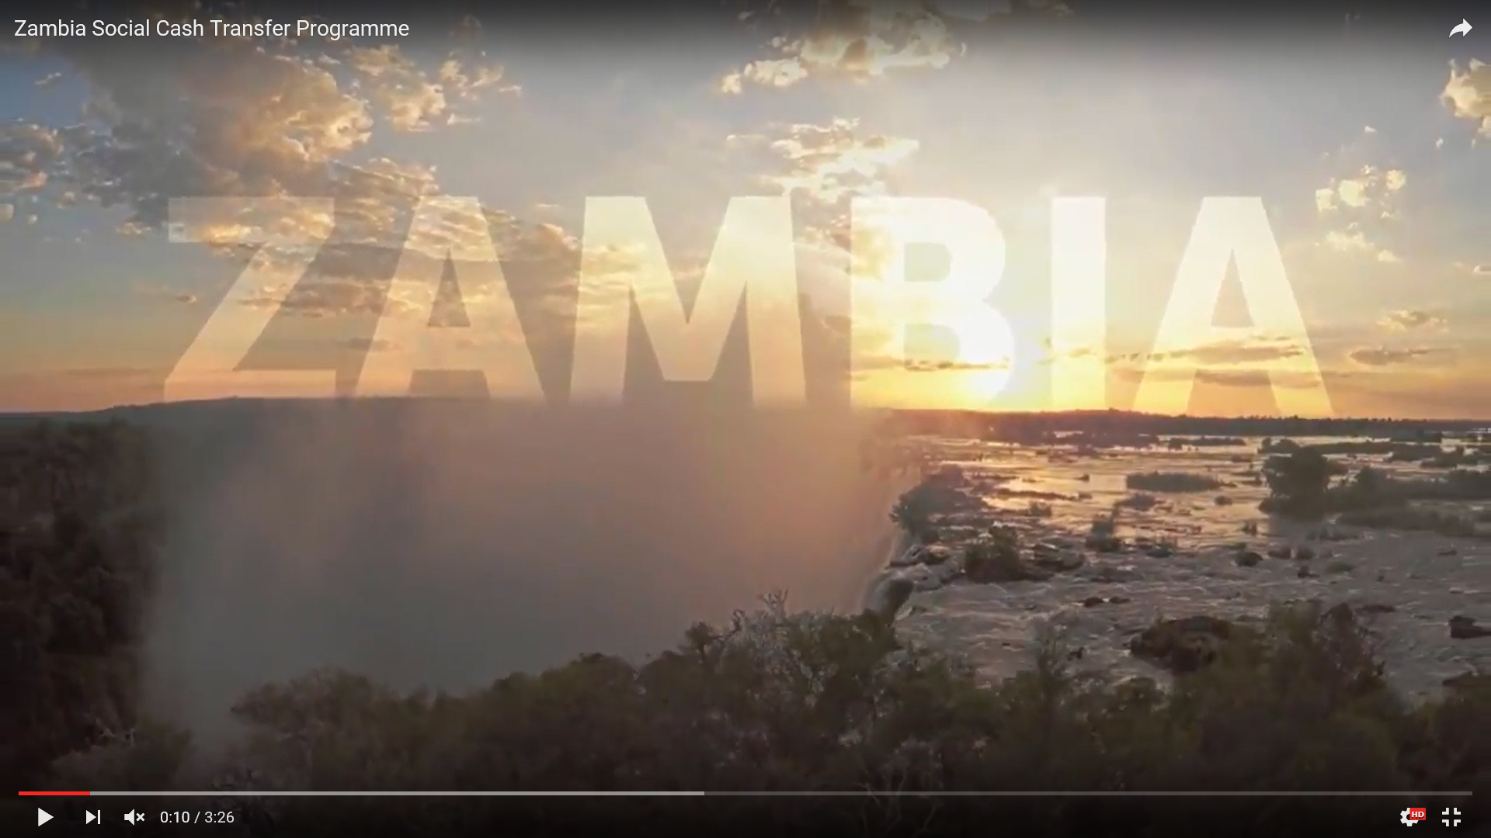
SOCIAL CASH TRANSFER PROGRAM
https://youtu.be/RSV6yhD0Lso

Slide 8
CASH TRANSFERS AS PART OF
SOCIAL PROTECTION POLICY
Linkages with other Social Protection services
  Social cash transfer and Social Health Insurance
  Livelihood programs and agriculture support
  Extension of social insurance to informal sector
Linkages with basic social services
  HIV prevention and care
  Nutrition
  Secondary education fee waiver
  Building on a stronger social welfare sector

Slide 9
DUTCH SUPPORT TO
SOCIAL CASH TRANSFER

Slide 10
DUTCH SUPPORT ON SOCIAL PROTECTION
Expansion and scale-up of HIV-sensitive social protection
phase I and II : 2015- 2018
Supporting HIV affected households and adolescents
  HIV Prevention
  Social workers support
Supporting Systems Linkages in Zambia
  Cooperation between clinics, social workers and paypoint
Beyond receiving cash, the grant has supported HIV positive/ affected beneficiaries to overcome stigma, access health services and even adhere to their HIV treatment
Notes:
Dutch funds instrumental in creating linkages between Social Proteciton programme and HIV services for adolescents
4 districts Lukulu, Senanga, Lufwanyama and Itezhi-tezhi
Supporting HIV affected households and
adolescents:
l HIV Prevention: Adolescents in households that
receive the grant under the Dutch project, are now
benefitting from HIV awareness-raising activities in
their communities. The project has been increasing the
capacity of 1,000 community workers delivering cash
transfers at pay points to double up through providing
sexual and reproductive health messaging. Pay points
are often centrally designated locations for collection of
cash in communities and they can easily provide a
platform for information sharing. Further, UNICEF is
sensitizing community leaders, caregivers and
adolescents on HIV and adolescents.
HIV services case management: Through Dutch
support, UNICEF is also building community level
capacity for setting up HIV-sensitive case management
systems as part of the Social Cash Transfer
Programme reaching 3,000 adolescents (10-19 years).
Case management means thatbeyond delivering the
cash transfer, a community based worker regularly and
predictably visits a household to assess progress,
vulnerabilities and provides the relevant information/
Supporting Systems Linkages in Zambia
l UNICEF brokered an agreement between the medical
and social welfare offices to work together on
increasing the uptake of HIV services by adolescents
in communities implementing the SCT programme in
the four districts. Both offices are doing joint planning
and implementation.
l At the local levels, the child protection system
framework and the cash transfer programme meet.
While the CWACs’ capacity is strengthened to deliver
the cash transfer programme, it is planned that child
protection will use the system to prevent and respond
to child abuse.

Slide 11
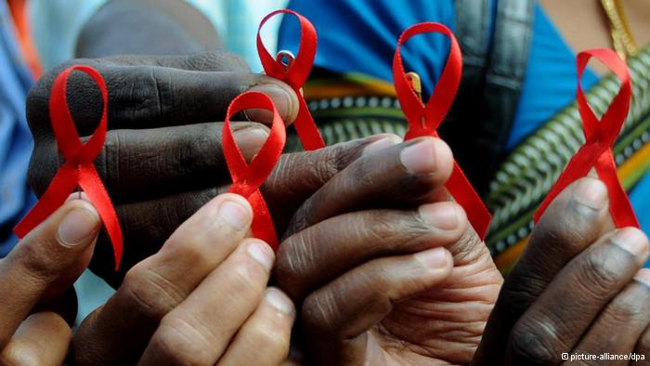
HIV-SENSITIVE SOCIAL PROTECTION
FROM HIV-SPECIFIC TO HIV-SENSITIVE
FROM ‘AIDS ORPHANS’ TO ‘VULNERABLE CHILDREN’
FROM PILOT TO SYSTEMS

Slide 12
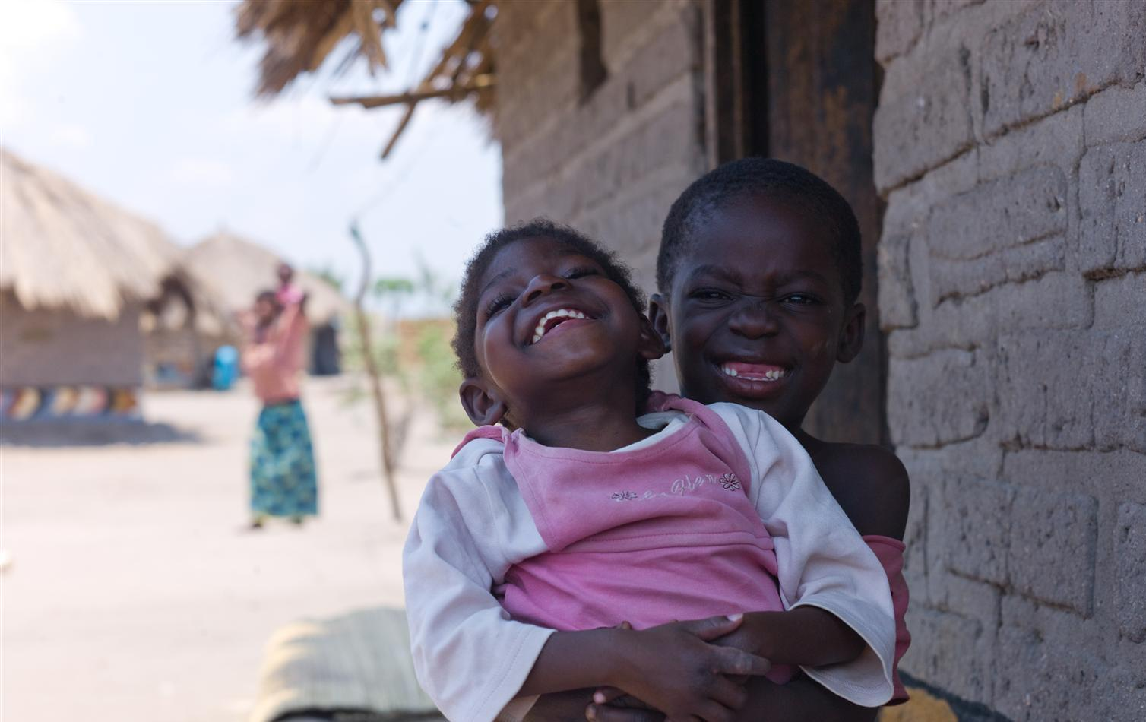
Findings from the impact evaluation
Notes:
Randomized Control Trial
Difference between control and treatment group, same situation at baseline, can be attributed to the programme
Implemented by American Institutes for Research and University of Zambia
Schemes evaluated:
Child Grant (children < 5 years of age)
Multiple Category Grant (widow-headed w/orphans; elderly- headed w/orphans; disabled members)
WHY the impact evaluation
to generate evidence about the effects
to make a case for cash transfers as a national programme for social protection
to inform the scale-up of the programme
to learn about its programme
to provide accountability for the use of public funds for cash transfers.
Audrien Kamona (8 yrs) holds her twin sister Odelia Chemba on her knee at home in Kantaramba
village in Kaputa district in Zambia's Northern Province on October 31, 2011. The family benefits from
the social cash transfer program for their 8 year old daughter, Odelia Chemba, living with disability.
Lemba says "Odelia can't feed herself, can't walk or talk or do any of the normal things that her twin
sister can do". Before she was enrolled in the transfer program, Lemba says "Life was difficult, we
never had three meals a day".

Slide 13
BENEFIT TO HOUSEHOLD LARGER THAN
THE VALUE OF TRANSFER
 | MCTG | CGP
Annual value of transfer (A) | 720 | 660
Savings | 10 | 61
Loan repayment | 23 | 27
Consumption | 966 | 800
Livestock value | 183 | 48
Productive tools value | 25 | 50
Total spending (consumption + spending) (B) | 1202 | 986
Estimated multiplier (B/A) | 1.67 | 1.49
Each Kwacha transferred is now providing 70 percent more in terms of net benefit to the household.
Notes:
MCTG Multiplier Effect = 67% More Kwacha, a bit lower in CGP, but probably statistically they are the same. Interesting, MCTG, w/o able-bodied people, also generates a multiplier—comes from livestock and agric production
Impacts are based on econometric results and averaged across all follow-up surveys.
Estimates for productive tools and livestock derived by multiplying average increase (numbers) by market price. Only statistically significant impacts are considered.
After 3 years of programme implementation, the overall impacts of the programme sum to a value that is greater than the transfer size. The programme was originally designed with the transfer size equal to roughly one additional meal a day for the average family for one month. However, the evaluation revealed that in addition to eating more meals and being more food secure, families are also improving their housing conditions, buying more livestock, buying necessities for children, reducing their debt, and investing in productive activities. Monetizing and aggregating these consumption and non-consumption spending impacts of the MCTG gives an estimated multiplier of 1.68. In other words, each Kwacha transferred is now providing an additional 0.68 Kwacha or roughly 70 percent more in terms of net benefit to the household. These multiplier effects are derived mainly through increased productive activity, including livestock rearing, agricultural production and diversification of income sources into non-farm enterprises.

Slide 14
IMPACTS ON MONETARY POVERTY GAP
The cash transfer reduces the depth of poverty in beneficiary households
Notes:
Main message here:
The transfer value is not enough to have families reach above the poverty line, given depth of poverty
Where the difference is made is in bringing them close to the poverty line, stabilizing and increasing their consumption
Graph shows improvements for control group as well but still the cash transfer makes a difference
Decreased Poverty: Three years into implementation, the programme obtains strong impacts on extreme poverty (a reduction of 9 percentage points) and on the poverty gap (a 12 percentage point reduction), ultimately decreasing the depth of poverty by bringing households closer to the poverty line. The poverty gap measures the difference between a household’s consumption and the extreme poverty line. The gap represents how much below the extreme poverty line a household is situated. In other words, this measure accounts for the distribution of individuals below the line rather than whether individuals moved above the line. The reduction in the poverty gap for MCTG recipients implies that more of the MCTG households are now closer to leaving extreme poverty. Additionally, the programme had greater effects on poverty reduction for those farther below the extreme poverty line.

Slide 15
IMPACTS ON FOOD CONSUMPTION
The cash transfer helps households to be more food secure throughout the year
Notes:
Food security prime concern and evaluation revealed significant improvements
Apart from quantity of food consumed (# of meals / day) we also saw that diversity of food consumed increased

Slide 16
IMPACTS ON SCHOOL ENROLLMENT SECONDARY AGE CHILDREN
9 point impact
6 point impact
12 point impact
children age 11+ more likely to be enrolled in school
Notes:
Similar impacts to those observed in Latin America
Primary enrolment already high, impacts mainly on secondary age groups

Slide 17
IMPACTS ON AGRICULTURE, SPENDING AND SAVINGS
The cash transfers increased productivity and asset ownership among beneficiary households.
Notes:
Selected overview of indicators that reveal impact on production and economic activity:
Important findings that address the perception that cash hand outs increase dependency and form a disincentive to work
Depending on demographic profile of families (labour capacity in particular) investments vary: more savings under the labour-constrained scheme and more crop production under child grant
We also saw a significant increase in the proportion of women with a non-farm economic activity – autonomy over resources important change
At baseline, crop expenditure is 21 and 48 in CGP and MCTG
Any savings at baseline 17 and 13%
Productive Impacts: The MCTG generates impacts on production activities of beneficiary households, in addition to the poverty, food security, and human capital outcomes discussed. In particular, the MCTG increased asset ownership and farm productivity.
Asset Ownership: Besides reducing debt levels of recipient households, the MCTG enabled them to increase the amount of assets they own, such as livestock and household items. After 36 months, the MCTG demonstrated a positive impact on the ownership of a wide variety of livestock, both in the share of households with livestock and in the total number of animals. As a result of the transfer, the number of recipient households that owned chickens increased by 26 percentage points and for goats it increased by 23 percentage points, with 61 percent of recipient households owning chickens and 26 percent of recipient households owning goats after three years of programme implementation. Households receiving the transfer are more likely to own a bed, a mattress, a charcoal iron, and a radio. For some of these assets, programme impacts are quite large. For example, the proportion of beneficiary households that own a mattress at 36 months is about 51 percent, whereas only 27 percent of control households own a mattress.
¹
Farm Productivity: The MCTG strengthened existing flows of income through increased farm production The share of households producing maize and groundnuts each increased by 11 percentage points. Additionally, the share of households cultivating beans increased significantly (by 17 percentage points). This production occurred through hiring labour to farm more land. The MCTG had a significant impact on total operated land (which on average increased by 0.16 hectares) and expenditure on inputs, primarily hired labour and fertilizer

Slide 18
IMPACTS ON THE WIDER COMMUNITY
Local economy multiplier ->
Subjective wellbeing of non-recipients in social cash transfer communities higher than perceived wellbeing of non-recipients outside social cash transfer communities
Cash Transfer perceived as affecting social dynamics: relationships between households, social inclusion, enhanced dignity
Notes:
Yet - poor people are poor in people,
Yet - coverage of cash transfers is low and hence less likely to induce significant ‘transformation’ in communities)

Slide 19
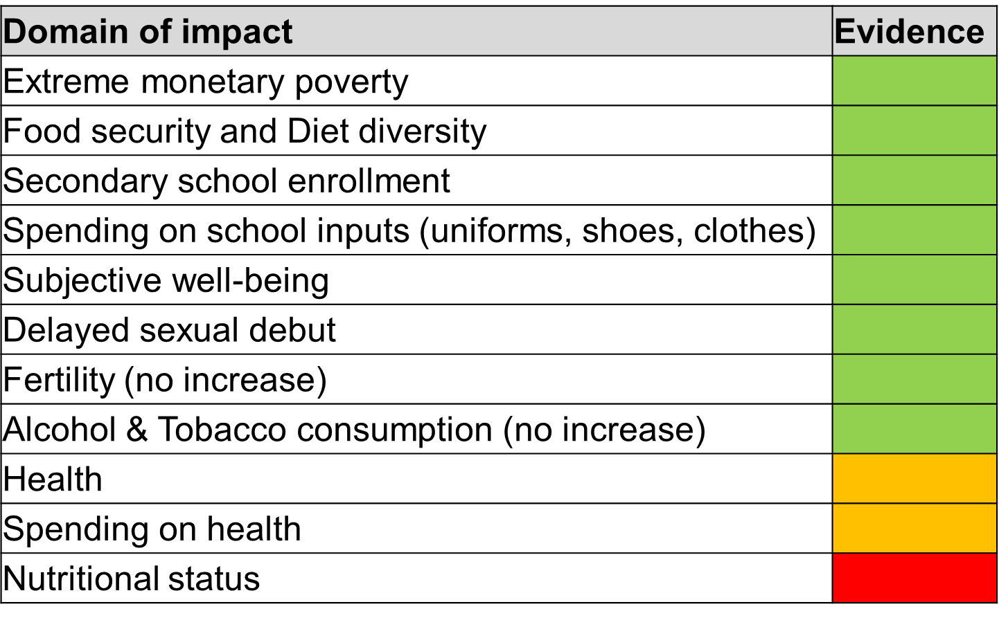
IMPACT EVALUATIONS
EASTERN AND SOUTHERN AFRICA
Notes:
Zambia: evidence on housing conditions (sanitation; cement floors), feeding practices
In contexts with quality and accessible health services (Latin America, South Africa): impact on preventive care visits
Overall, impact on health status reveals mixed evidence (morbidity and health care utilization, such as immunization)
Conclusion:
Pathways of impact and non-impact are unclear
Much of the evidence on health is from conditional programs
Key indicators of interest:
Children’s diet diversity
Caregiver’s behavior towards infants
Intimate partner violence
Stress

Slide 20
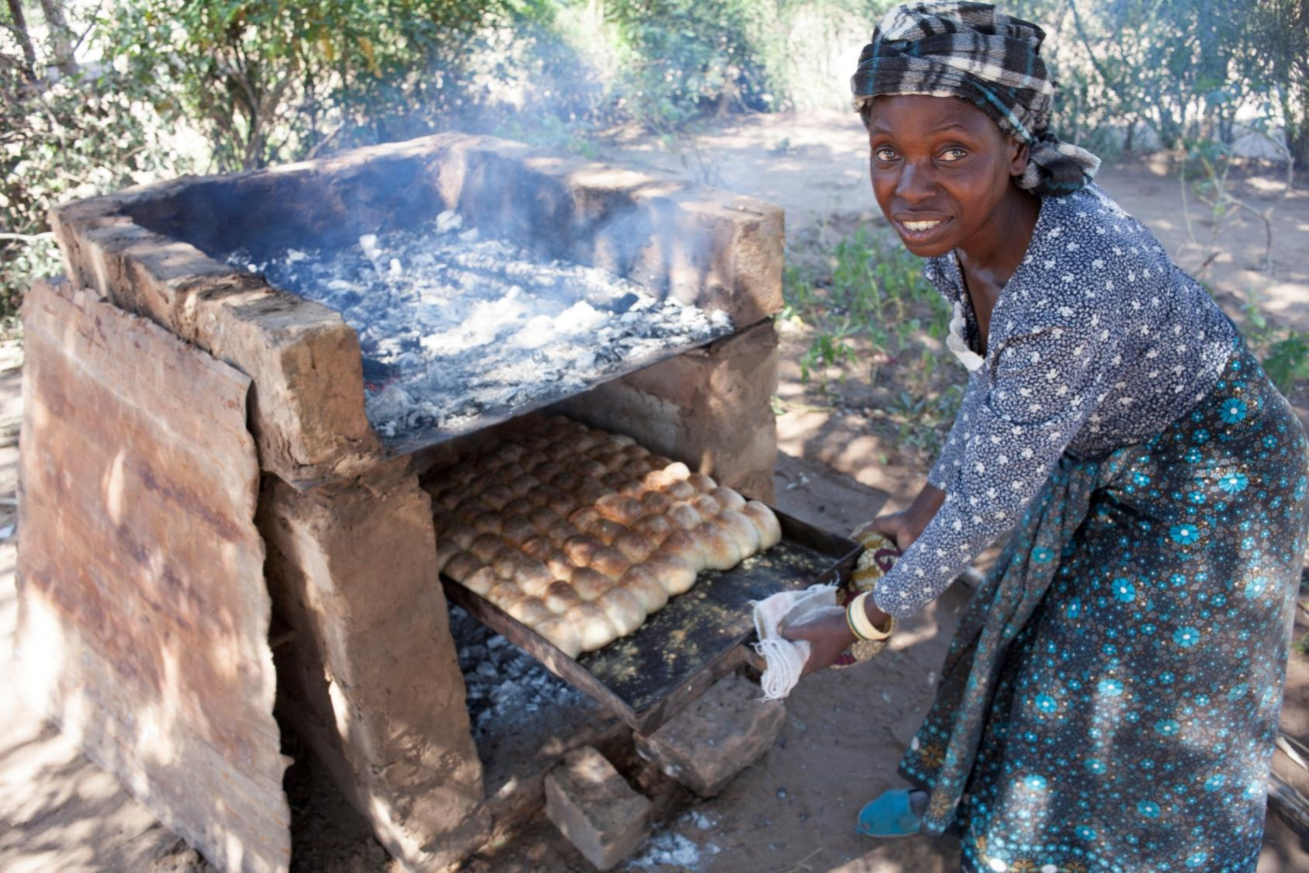
POLICY AND FINANCING
Implications
Notes:
Is it affordable?
Is it cost effective?
Is it inclusive?
Is there economic impact?
80% funded by Government. total budget remains < 1% of total Government expenditure
Cash transfers did not create dependency – they rather empowered households and strengthened their resilience to withstand shocks
Unconditional cash transfer programs such as the MCTG are often criticized for being a handout, leading to dependency and inducing perverse incentives such as reducing work and increasing the consumption of alcohol and tobacco. However, the multiplier effect of 1.68 generated by the MCTG appears to put to rest the concern that unconditional transfers are a “handout” or that the poor do not use their money wisely. These multiplier effects are derived from underlying investments into productive activities that yield extra income to the household. In the case of the MCTG, the extra income was earned through increased livestock and non-farm activity, as well as from purchases of agricultural inputs that in turn increased crop production. The MCTG also managed to deliver large increases in school enrolment, just as large as or larger than those reported from well-established conditional programs such as Colombia’s Familias en Accion and Mexico’s Progresa (now called Prospera). Moreover, in no survey round did the evaluation find an increase in alcohol or tobacco consumption as a result of the program. Most of the consumption effect of the MCTG goes to food, and in fact allows households to increase their diet diversity by adding more protein to it. All in all, the MCTG, similar to the Child Grant, demonstrates that the common criticisms of cash transfers are simply not true in Zambia. The results also suggest that advocates of conditional cash programs may do an injustice to poor families by imposing conditions. In fact, the results from the CG and MCTG demonstrate how families effectively use unconditional transfers to increase current consumption and to invest in the future of themselves and their children.
Is there complementarity with other development policies?

Slide 21
Notes:
Another way of looking at Social Protection expenditure is to make the cake all of Government transfers and subsidies payments
Which programs reach the poor? Example of FISP
How big is the cake? 4.2 billion Kwacha (about 400 million US dollars)
SCT: 300 million is needed to cover 240,000 beneficiaries – double the number of beneficiaries by a 25% reduction in fuel subsidies …… or FISP

Slide 22
POLICY IMPLICATION
Regularity and predictability of transfers facilitate planning, consumption smoothing and investment
Size of transfer matters (rule of thumb of 20% of mean consumption of target population)
Protection from inflation is key (trade-off coverage versus impact)
Supply side matters to maximize impact (supply of health and education, user fees)
Unconditional transfers address a wide spectrum of deprivations and vulnerabilities
Cash is important, but not sufficient: moving from cash to cash+ and establish systematic linkages with services
Notes:
All these lessons learned in one way or another bear relevance to nutrition
Significance of supply side factors
Example 1: Skilled attendance at birth improved in Zambia CGP, only among women with access to quality maternal health services.
Example 2: Anthropometry in Zambia CGP improved among households with access to safe drinking water

Slide 23
KEY MESSAGES
Social Protection is an investment, not a cost- it builds human capital and stimulates local economies
National cash transfer support for the poorest households comes at very little cost. It is financial sustainable: 1-2 per cent of GDP
Social transfers have significant HIV prevention, treatment and care impacts.
Children in families receiving cash transfers are more likely to enroll and complete school
Notes:
Improved Living Conditions: Beneficiaries also use the transfers to purchase items to improve their living conditions. For example, the MCTG induced a 9 percentage point increase in the number of households that own a mosquito net (which now stands at 89 percent). Owning a mosquito net is important for reducing incidences of malaria. The findings also reveal that beneficiaries improved their daily living conditions by purchasing torches or candles to light their home instead of using an open fire. Over half the households used open fire to light their home at baseline (57 percent). The MCTG had an 18 percentage point impact on the number of households using a purchased method
to light their home, such as candles or torch, with 82 percent of beneficiary households using a purchased method after three years¹. Wood smoke from an open fire is very harmful to one’s health, especially for children. Thus, the MCTG’s impact on reducing the use of an open fire in the home also contributes to reducing health problems caused by wood smoke.

Slide 24
Thank You
Pqvanufford@unicef.org

