Slide 1
INCLUSIVE DEVELOPMENT
Marleen Dekker

Slide 2
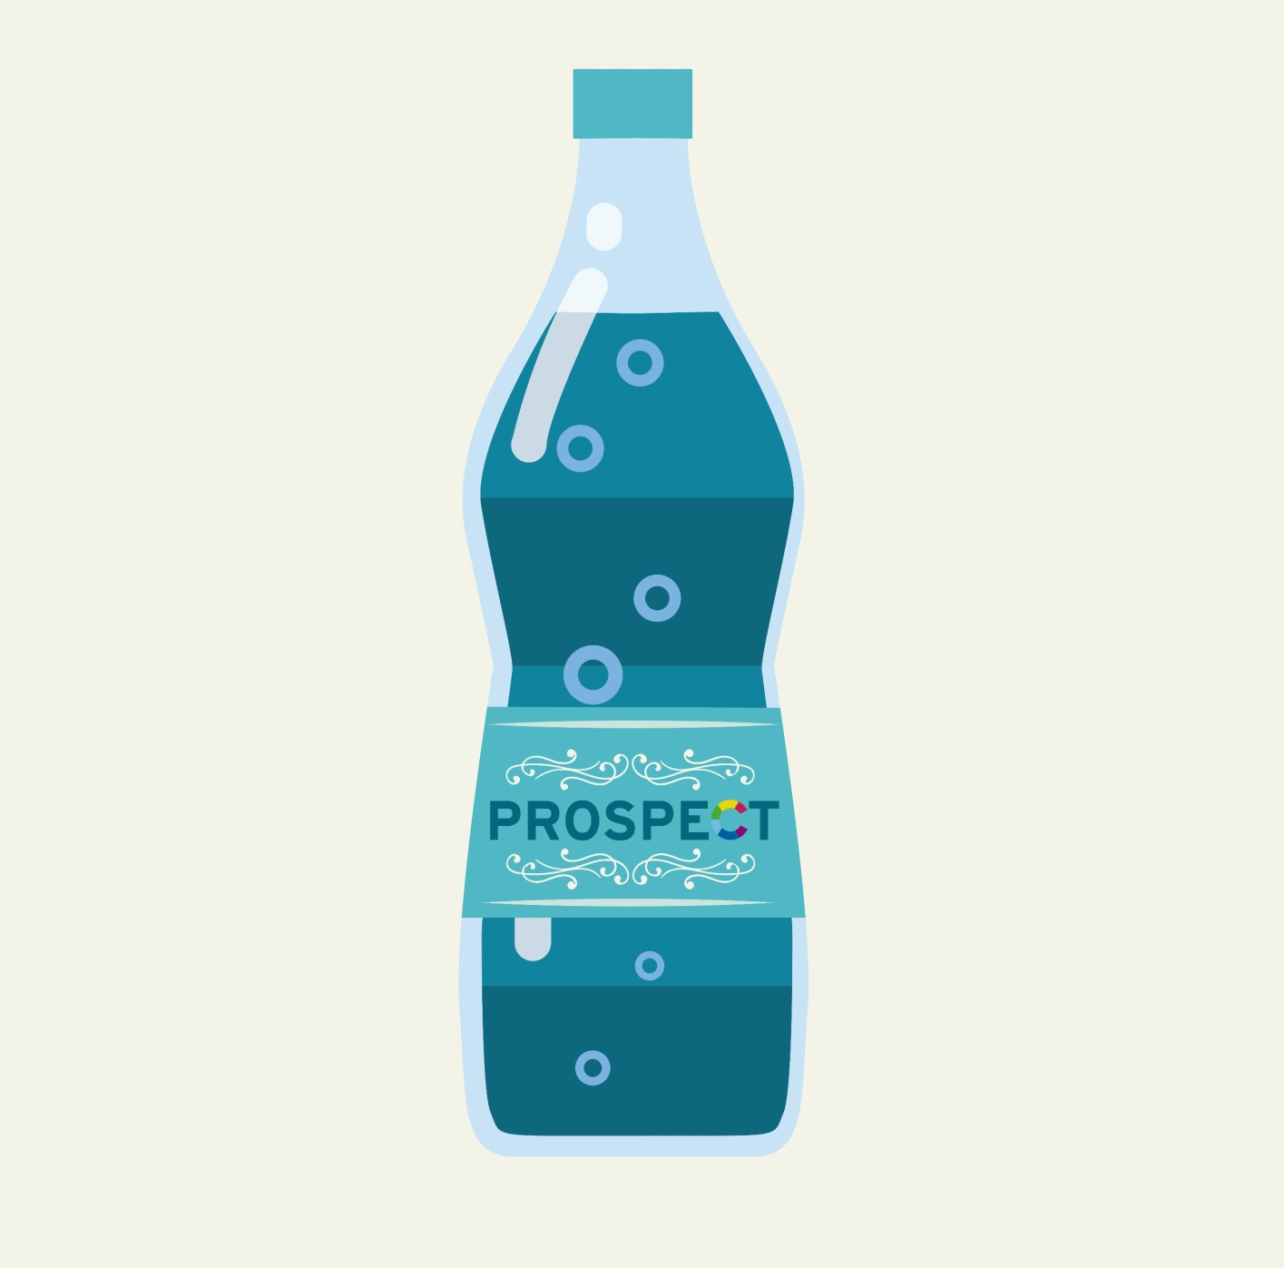

Slide 3
TRICKLE DOWN

Slide 4
Insufficient amounts
Differences increase

Slide 5
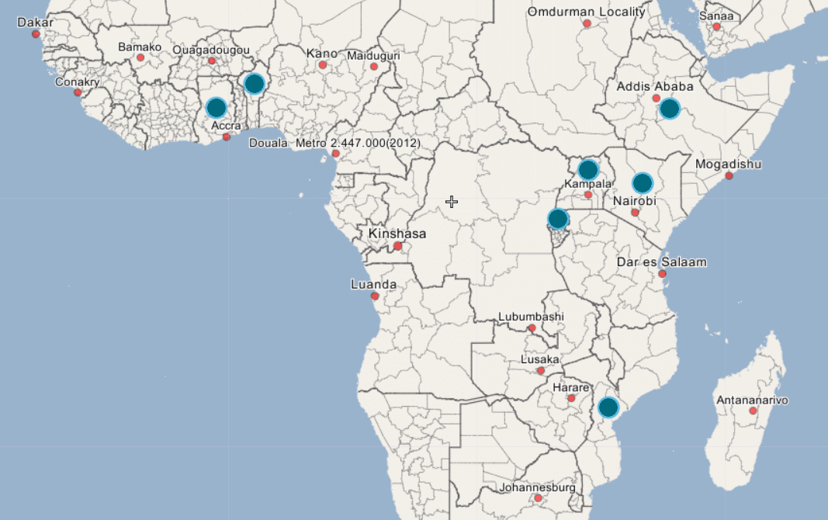
What to do instead of just ‘investment’?

Slide 6
‘Inclusive development’
Income and non-income dimensions of wellbeing
Average achievements in these dimensions improve
AND inequalities in these achievements fall
Inclusive development is both outcome and a process

Slide 7
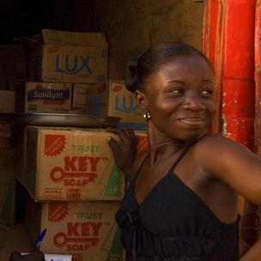
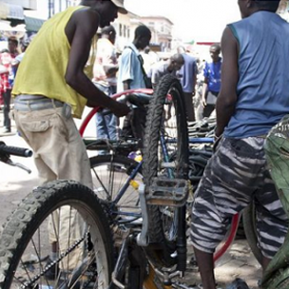
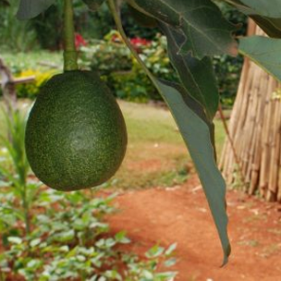
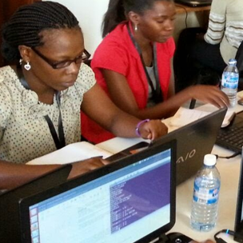
Key policy areas for inclusive development
Economic growth with structural transformation of the economy
Employment policies with a focus on productive employment
Reducing poverty and inequality by social protection
The provision of basic services
Territorial development and spatial equality
Quality of governance

Slide 8
Findings
Social protection → economic empowerment
Access to markets → increase incomes
Vouchers → agricultural productivity
Informal entrepreneurs → formal enterprises
Representation → aim for unity in action

Slide 9
Findings
But!
Usually not equally distributed
Measures tend to benefit those that are already in a preferable position more

Slide 10
Inequality is bad
For economic growth, social cohesion and political stability
Redistribution helps economies to grow faster and more sustainable

Slide 11
Lessons
Economic (sub) sectors and geographical areas
Monitor who is benefiting and adjust
Understand the needs and constraints of ´excluded´ people and try to pull them in
Increase impact of an intervention in context
Combine interventions for more inclusive impacts
Identify strategic actors who can make a difference

Slide 12
